Slide 1
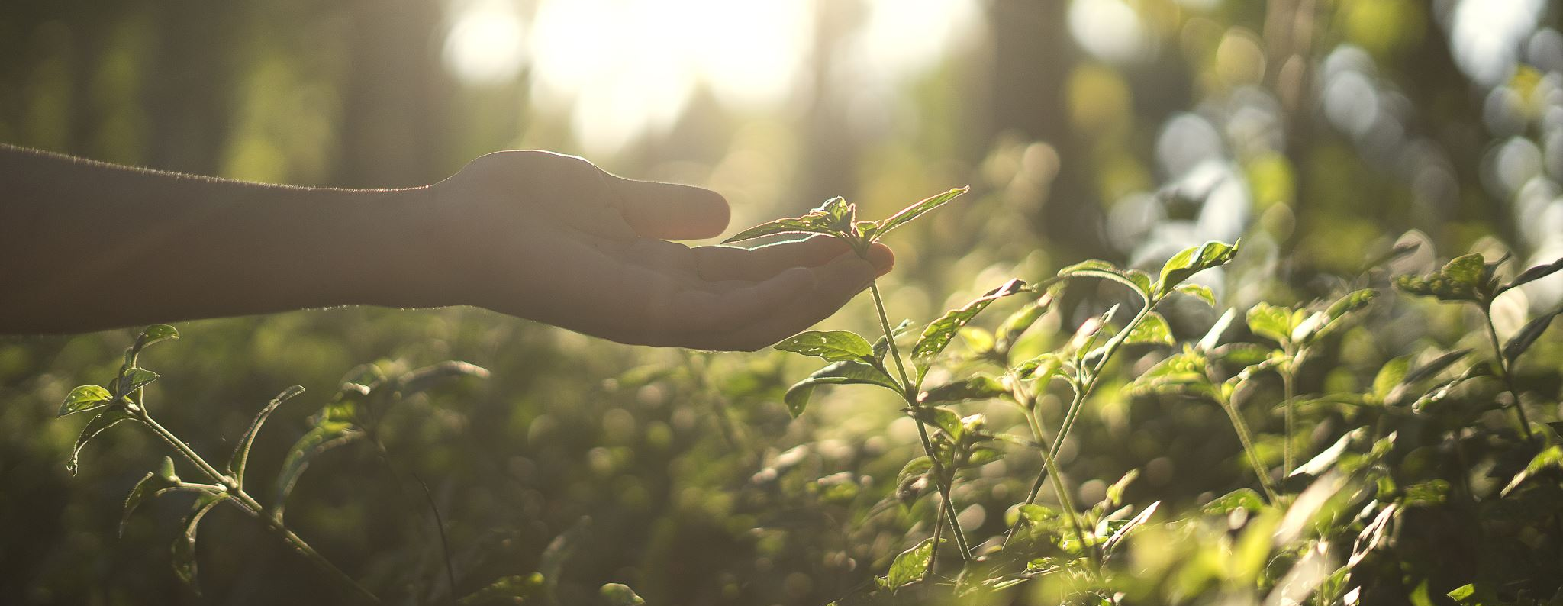
Nature conservation
Khatia Basilashvili

Slide 2
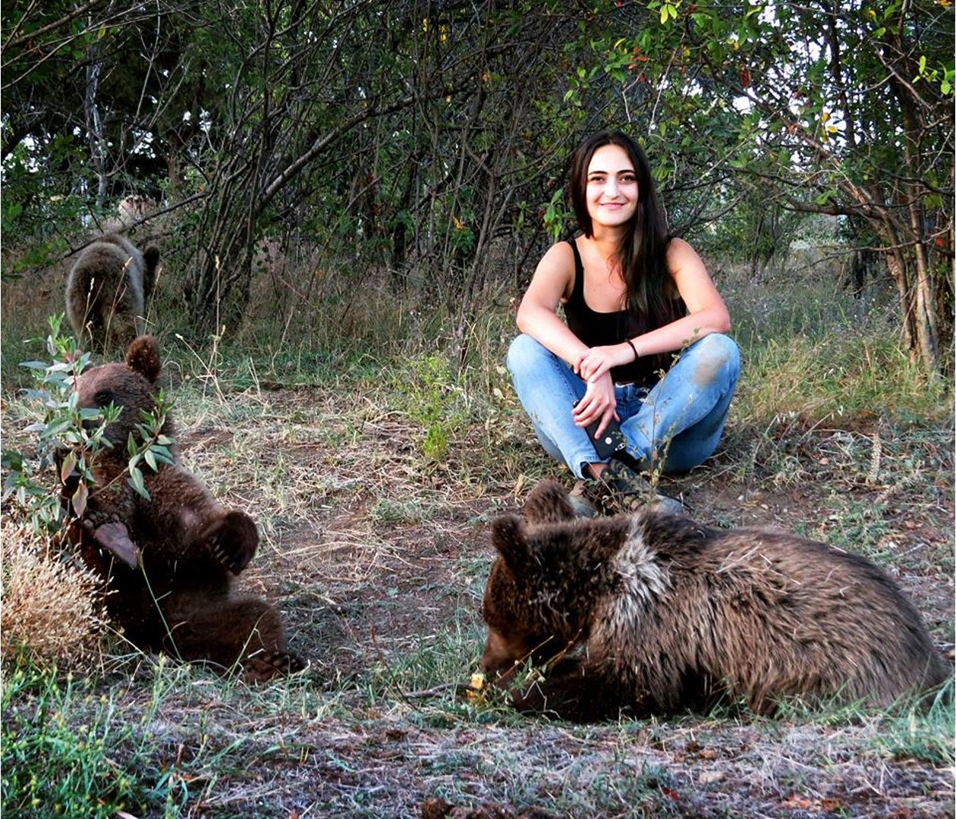
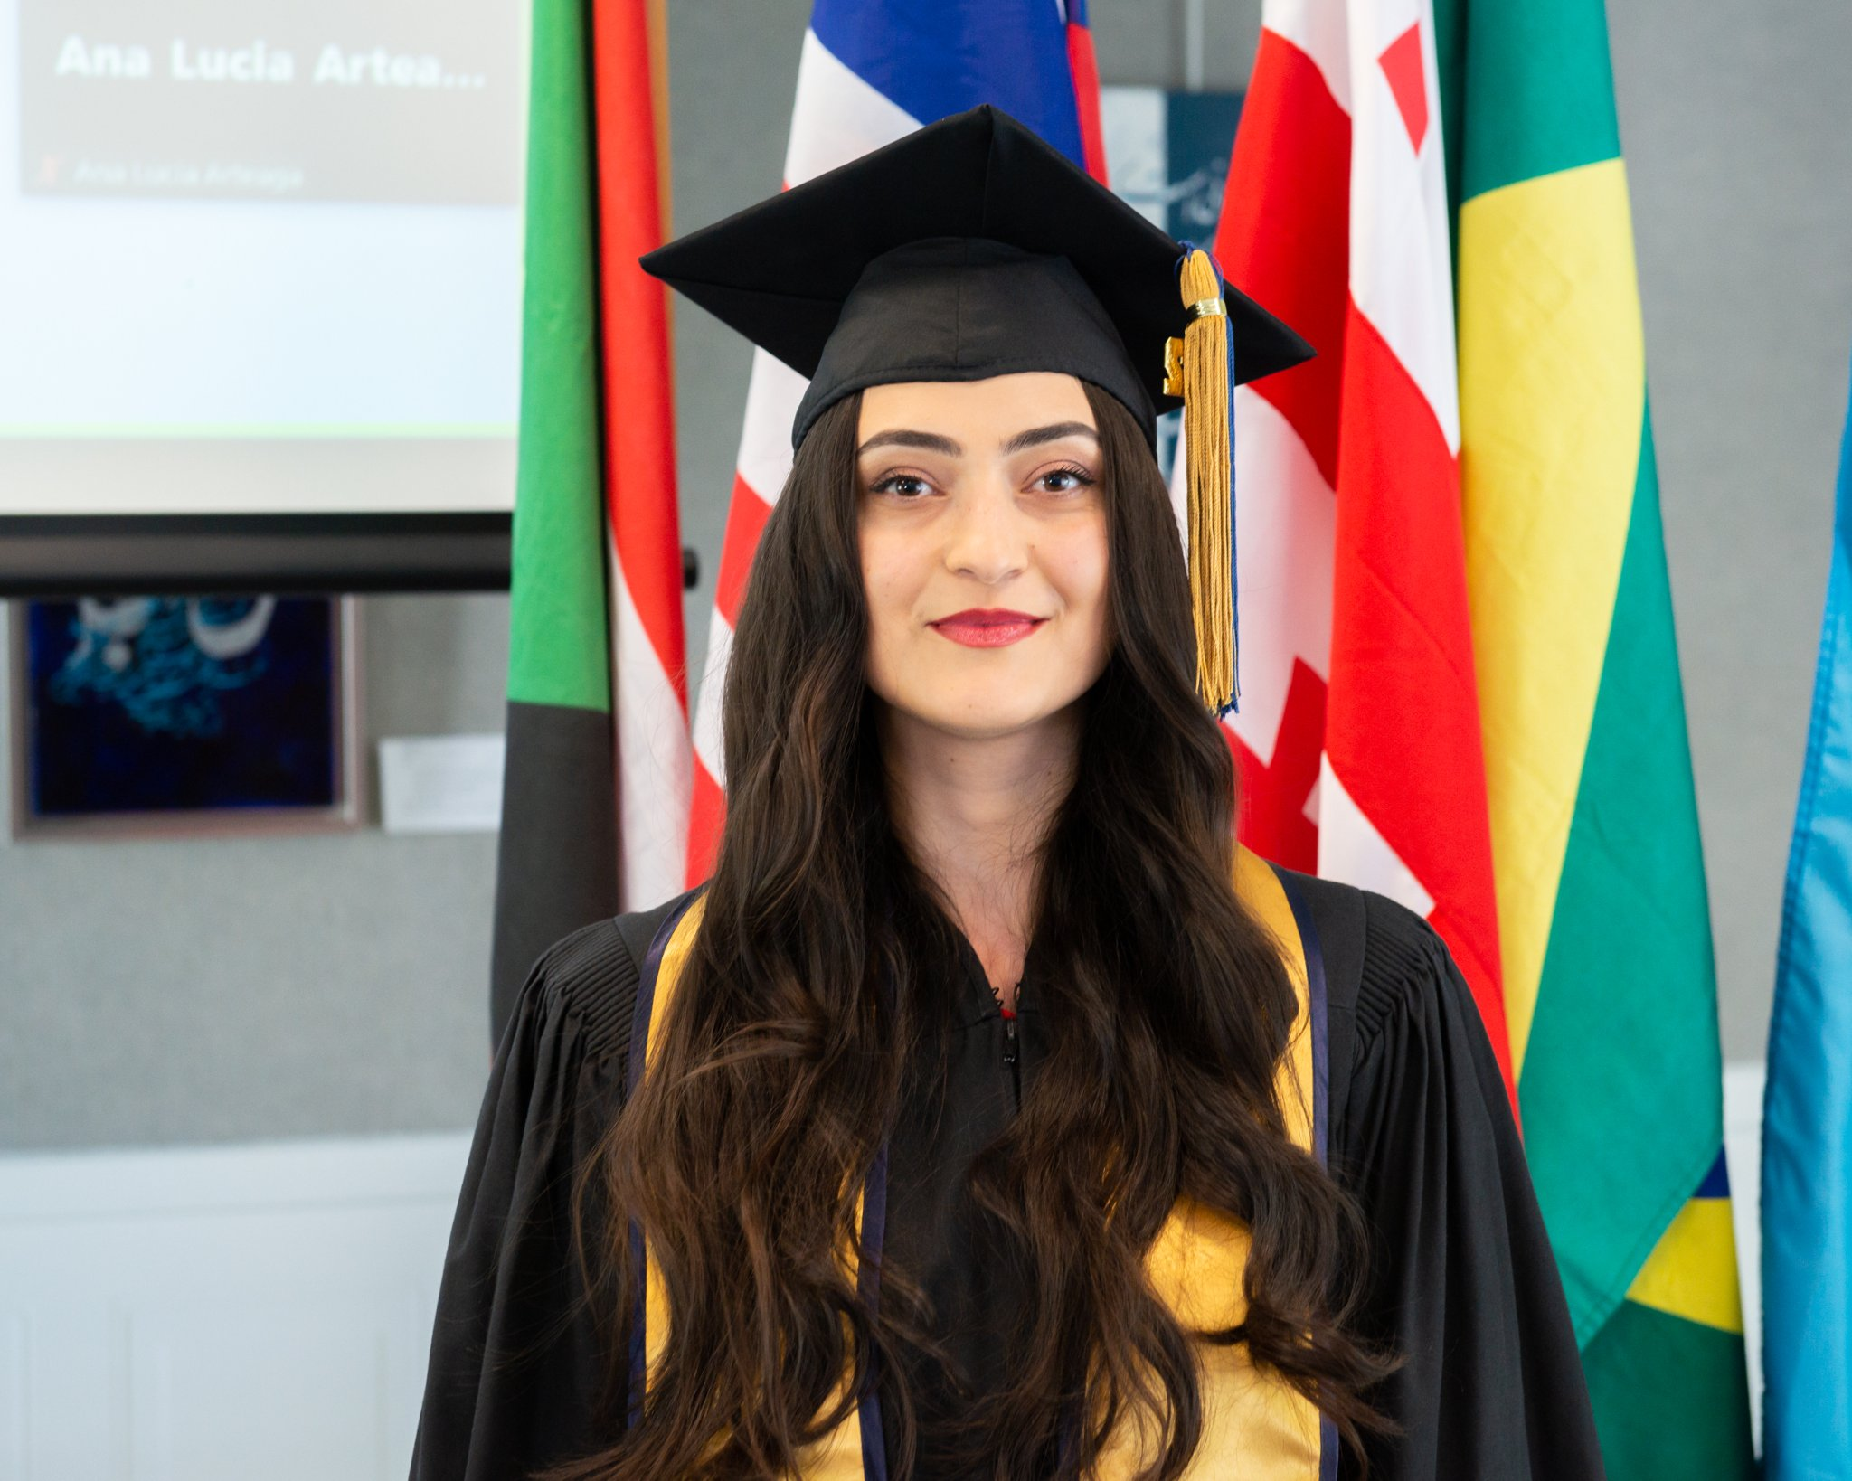
Who am I
z

Slide 3
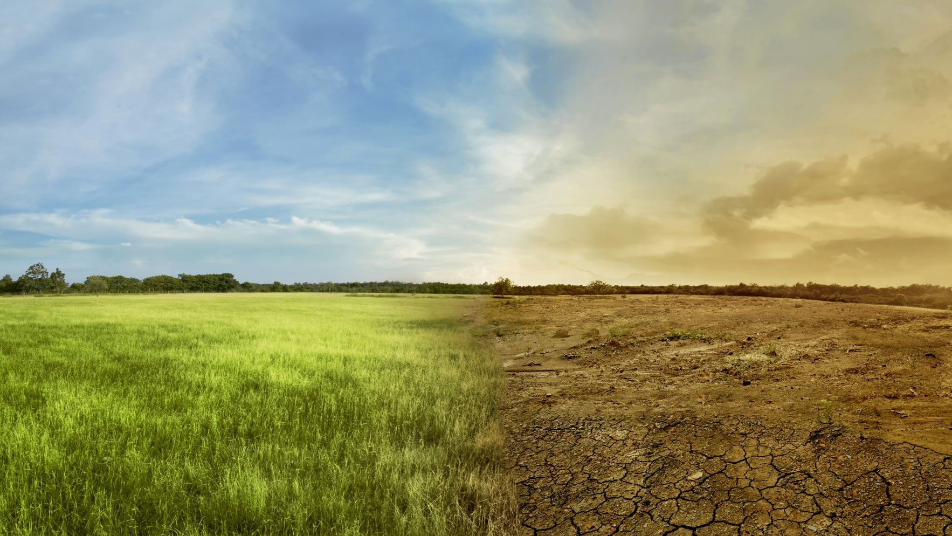
Why Conservation matters And…what is this conservation
It is maintaining the balance of ecosystems.
conservation is beneficial for our wellbeing such as preserving biodiversity, mitigating climate change, and providing ecosystem services, for example, agroecosystems, forest ecosystems, grassland ecosystems, and aquatic ecosystems.

Slide 4
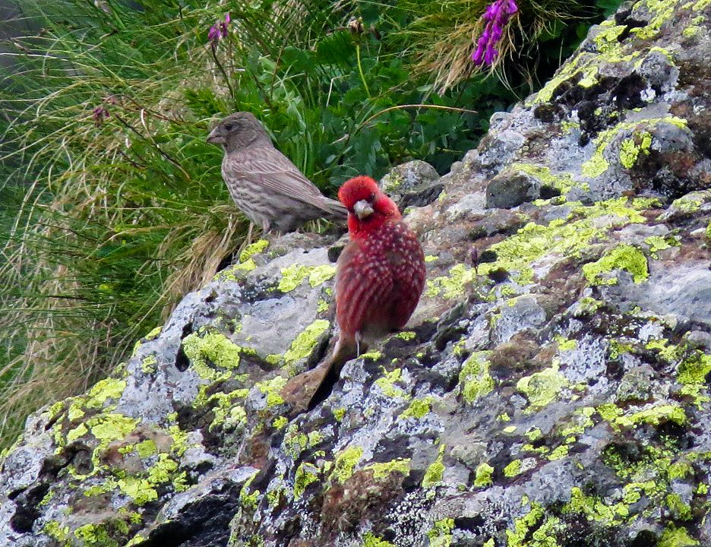
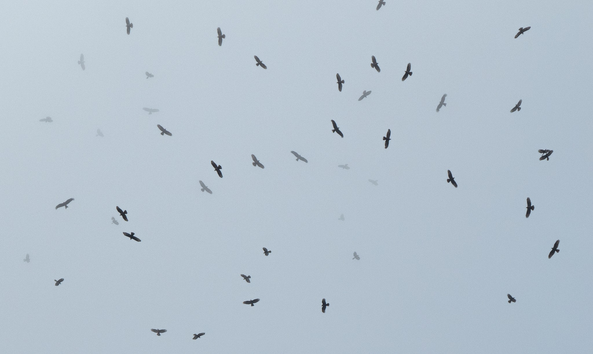
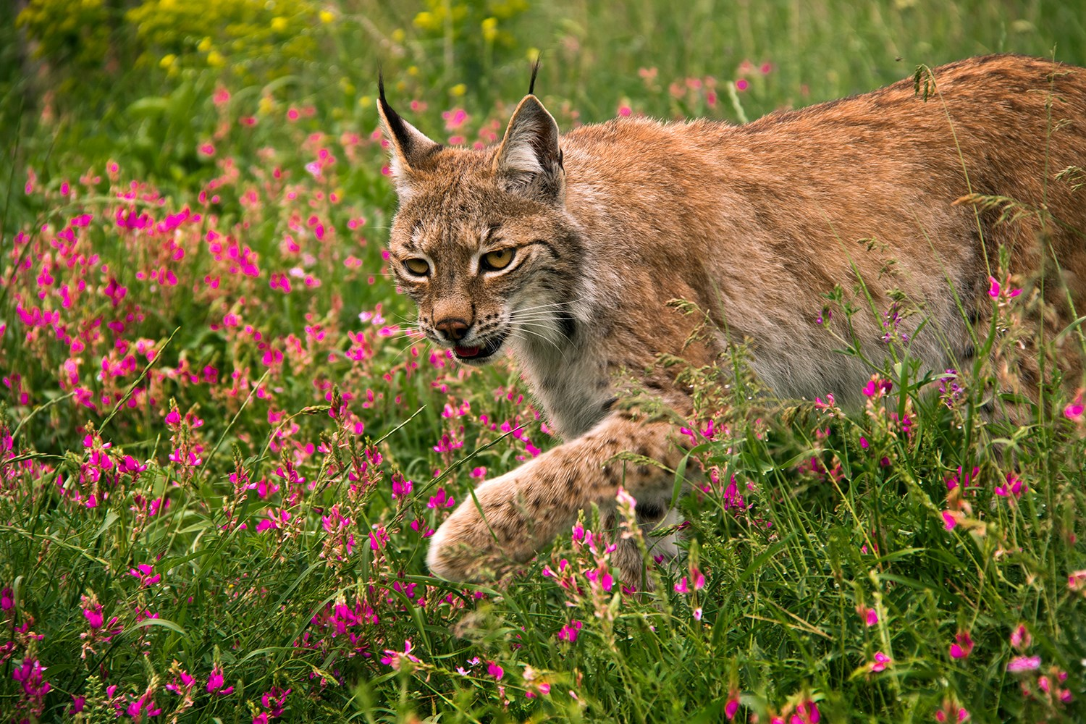
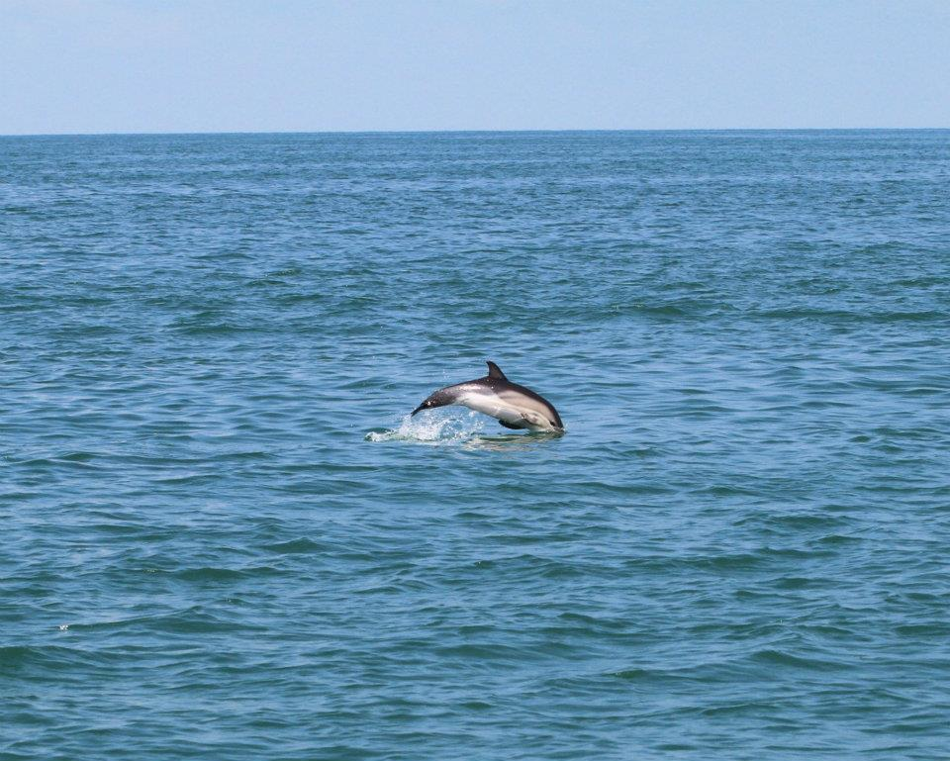
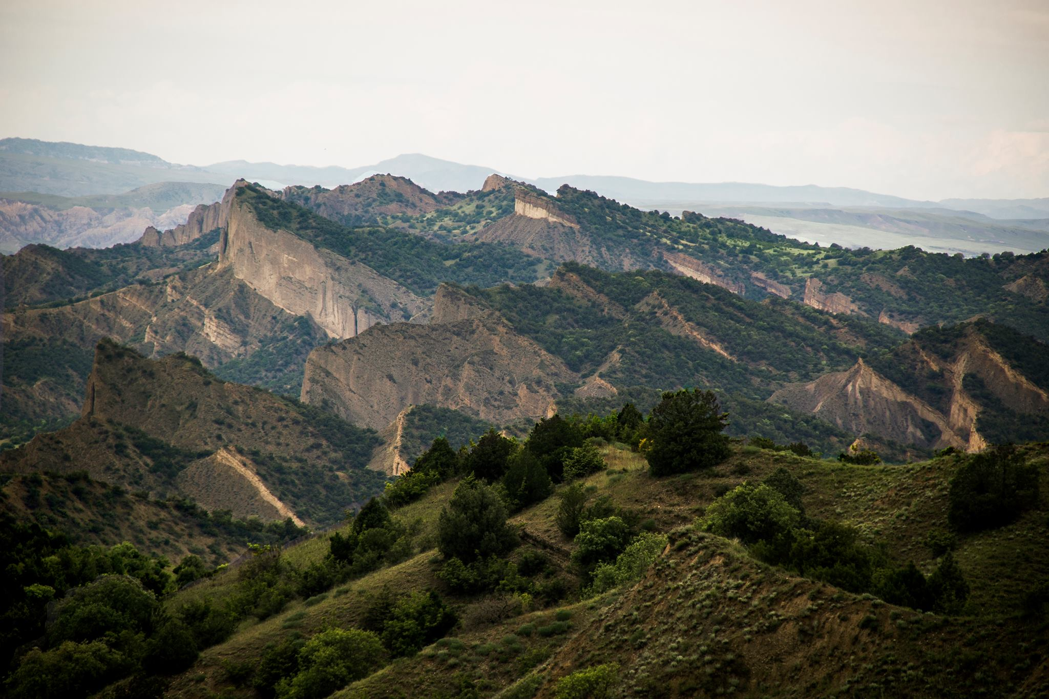
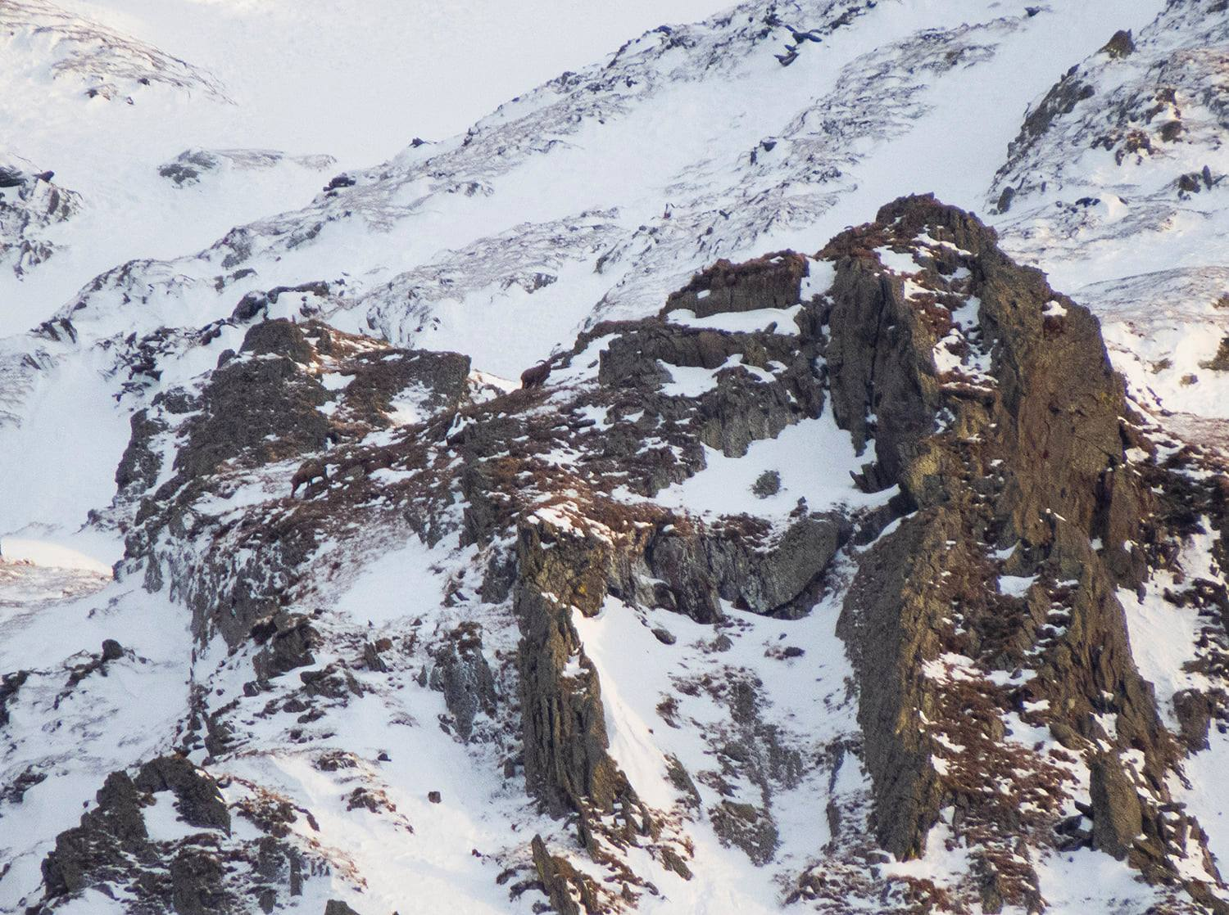
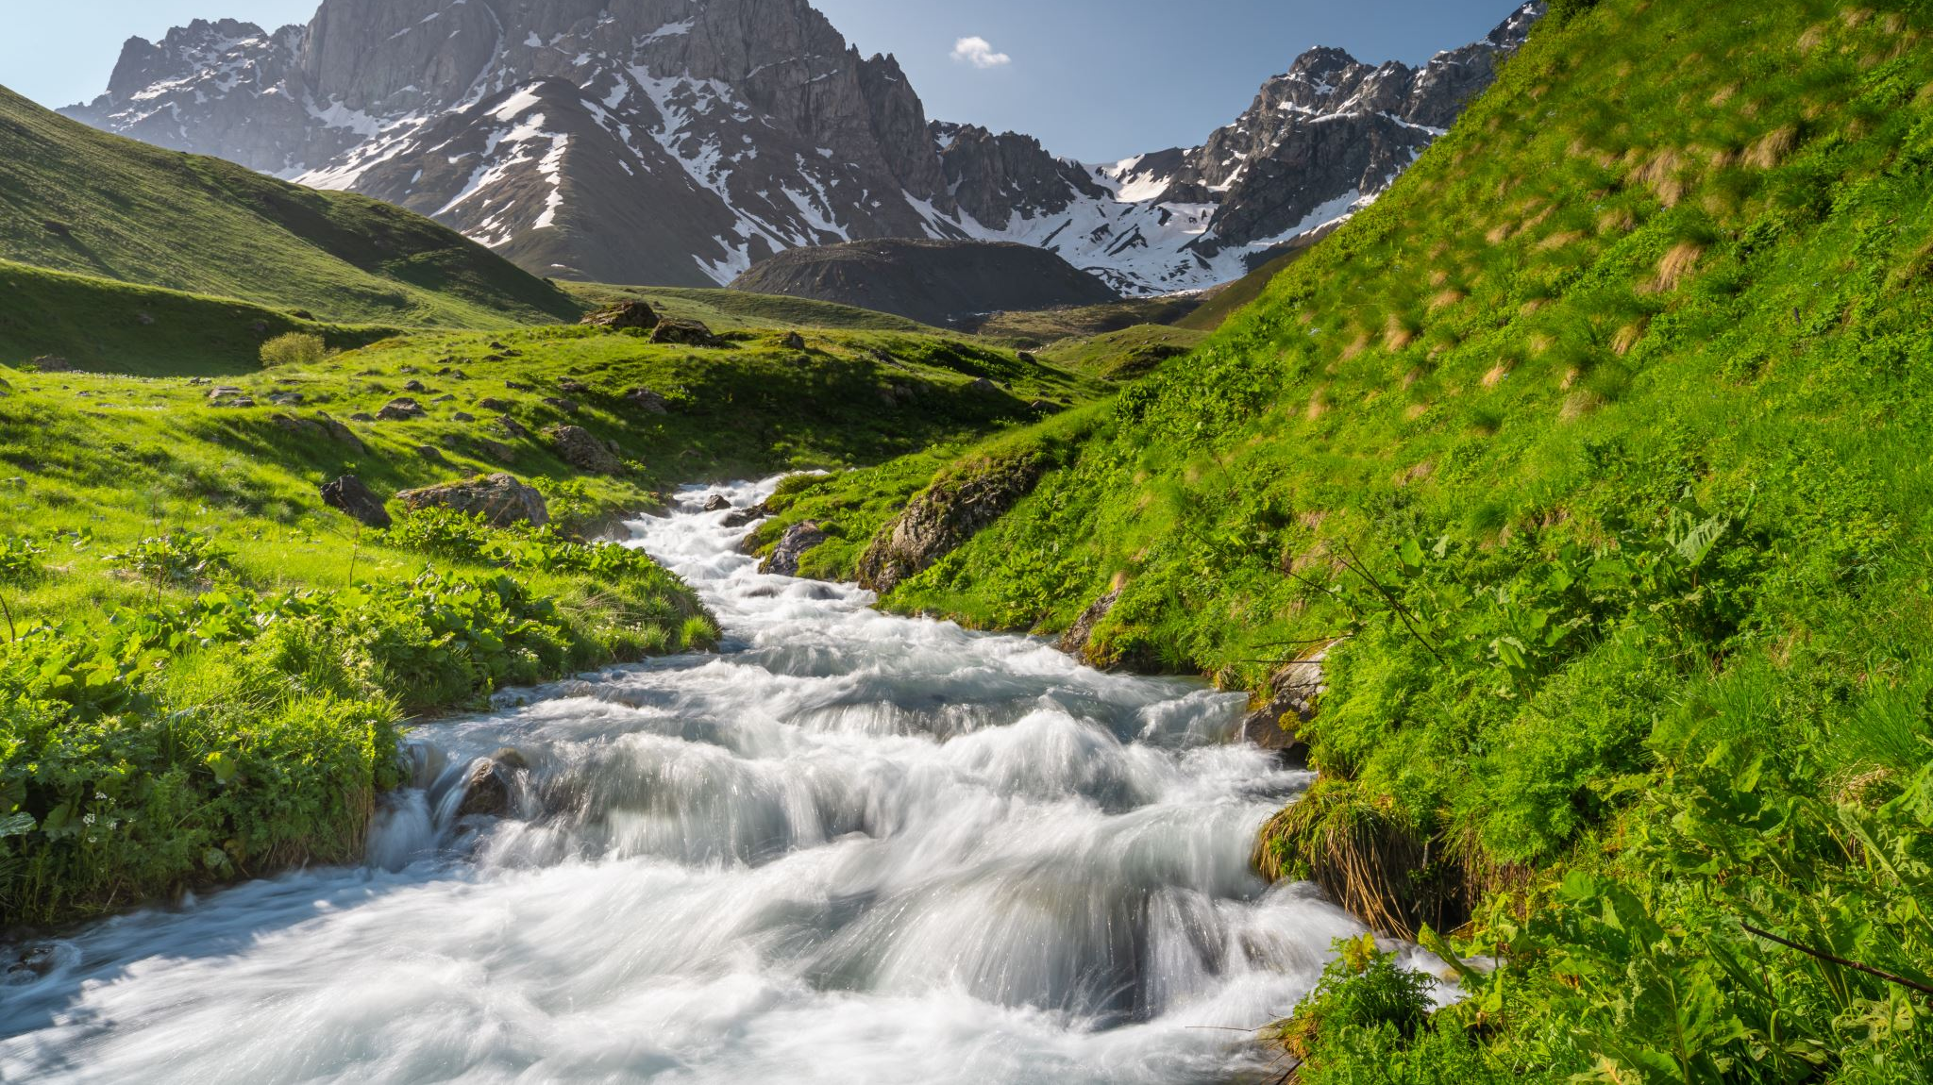
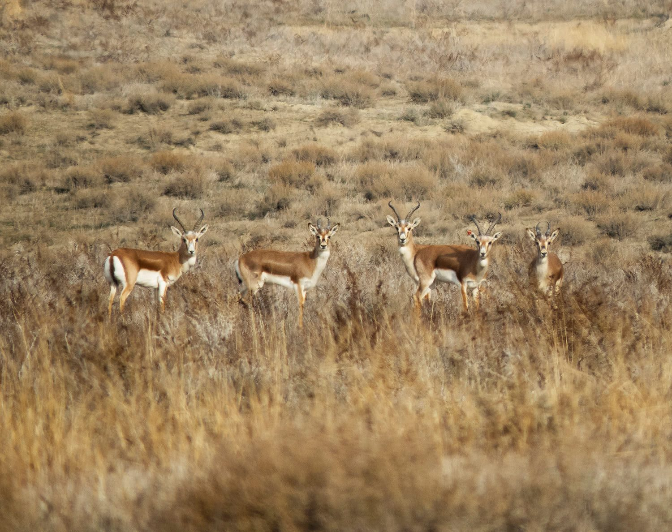
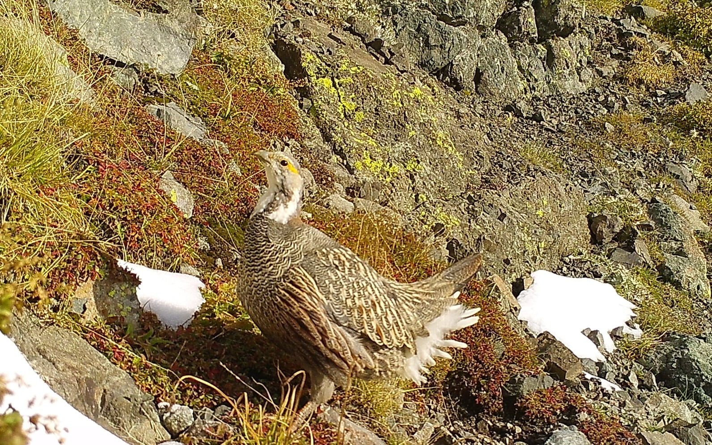
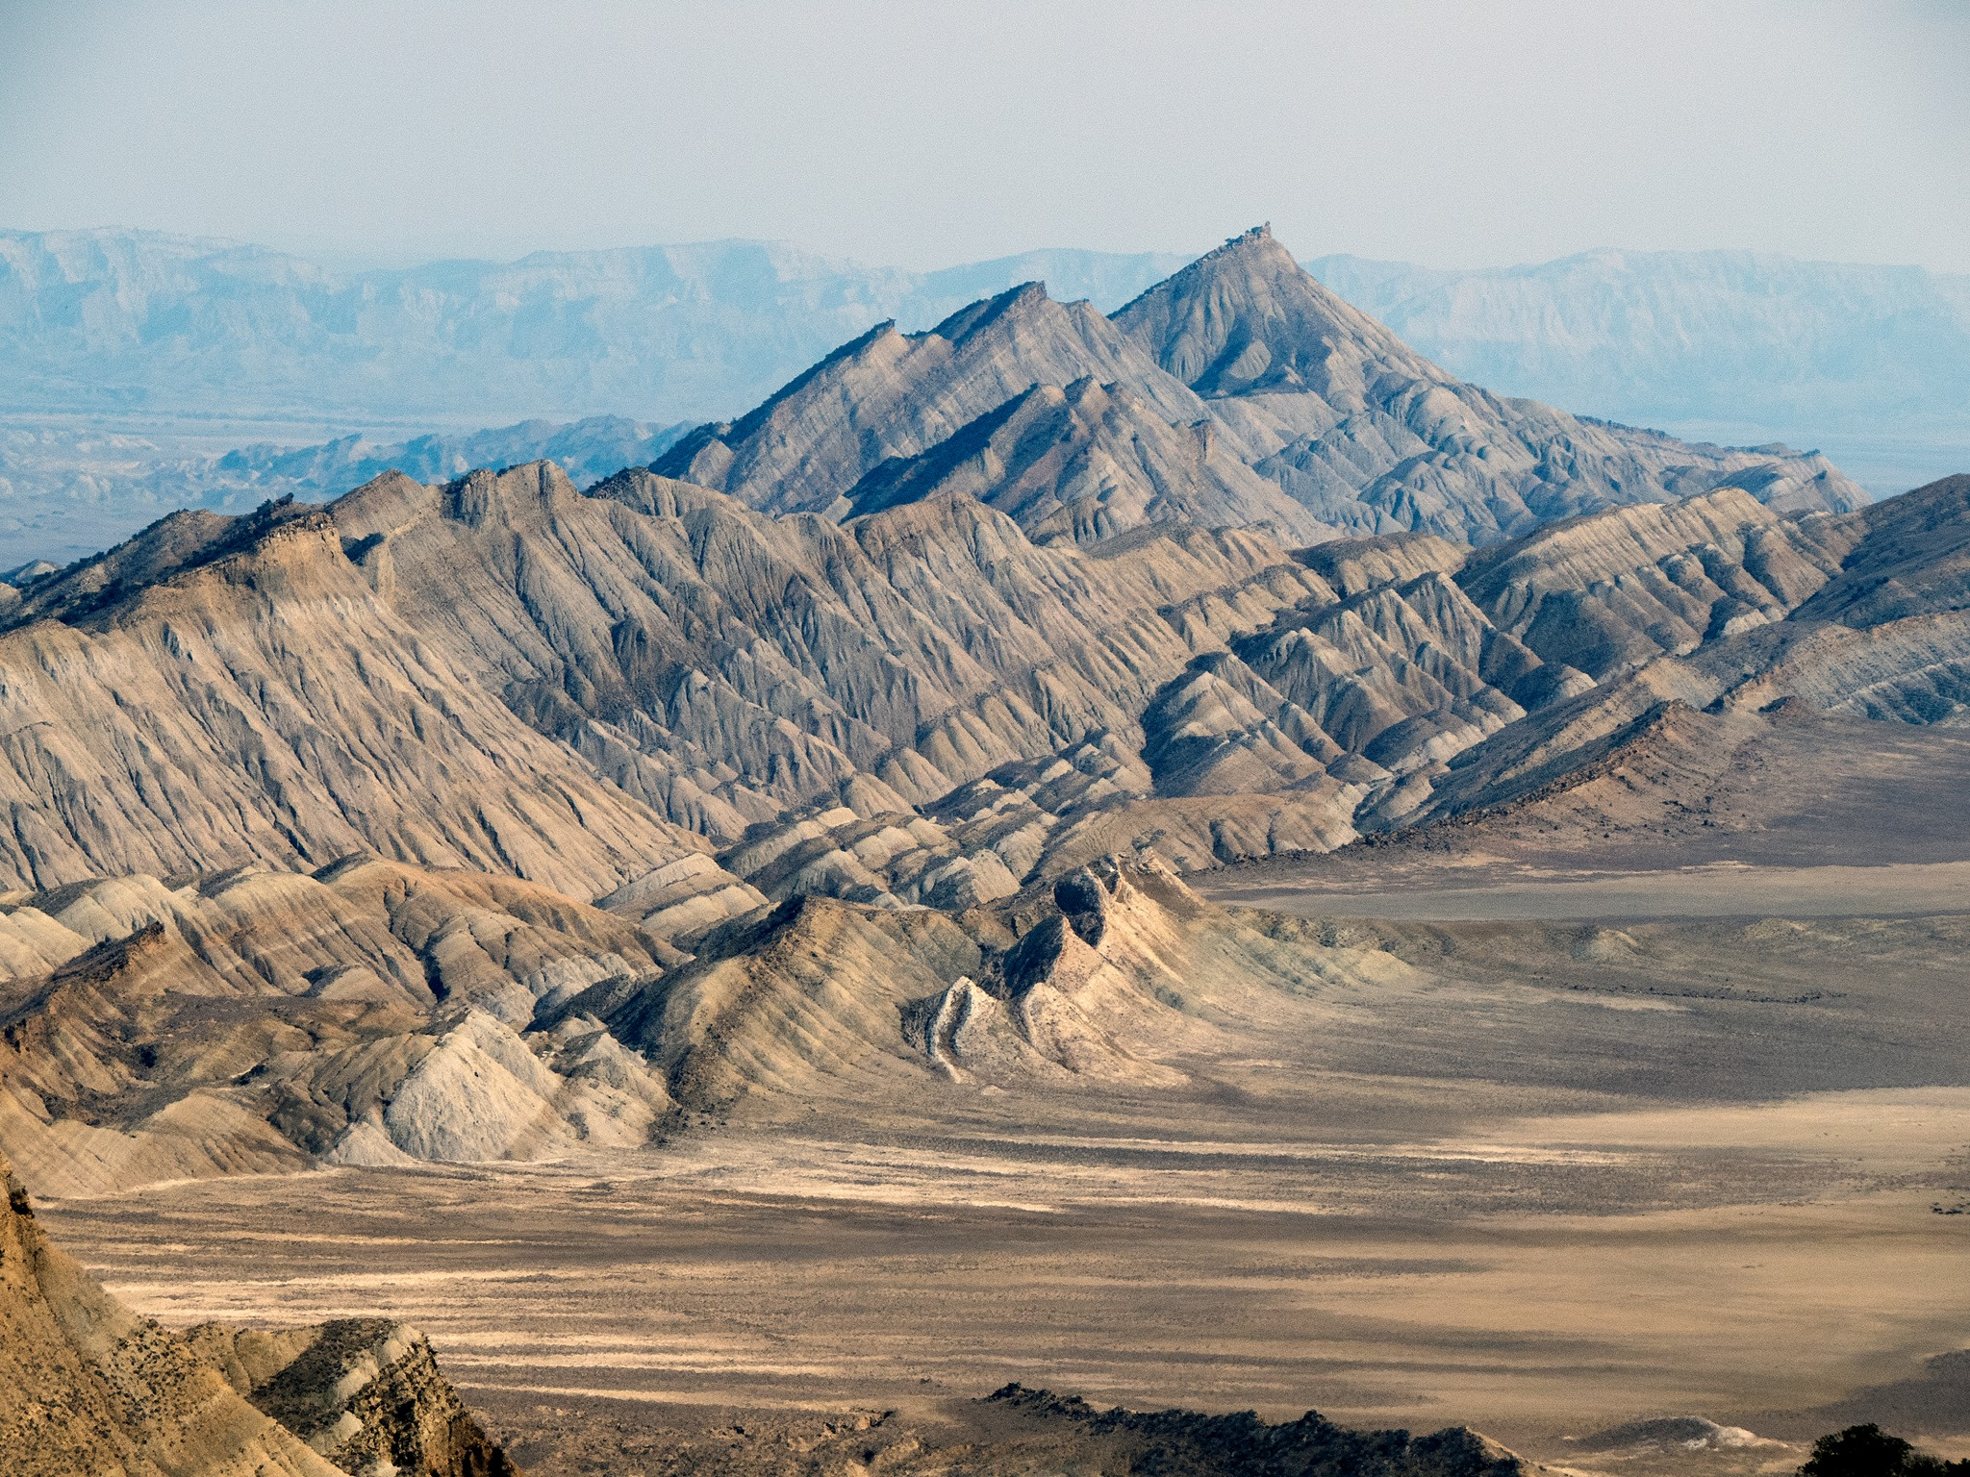
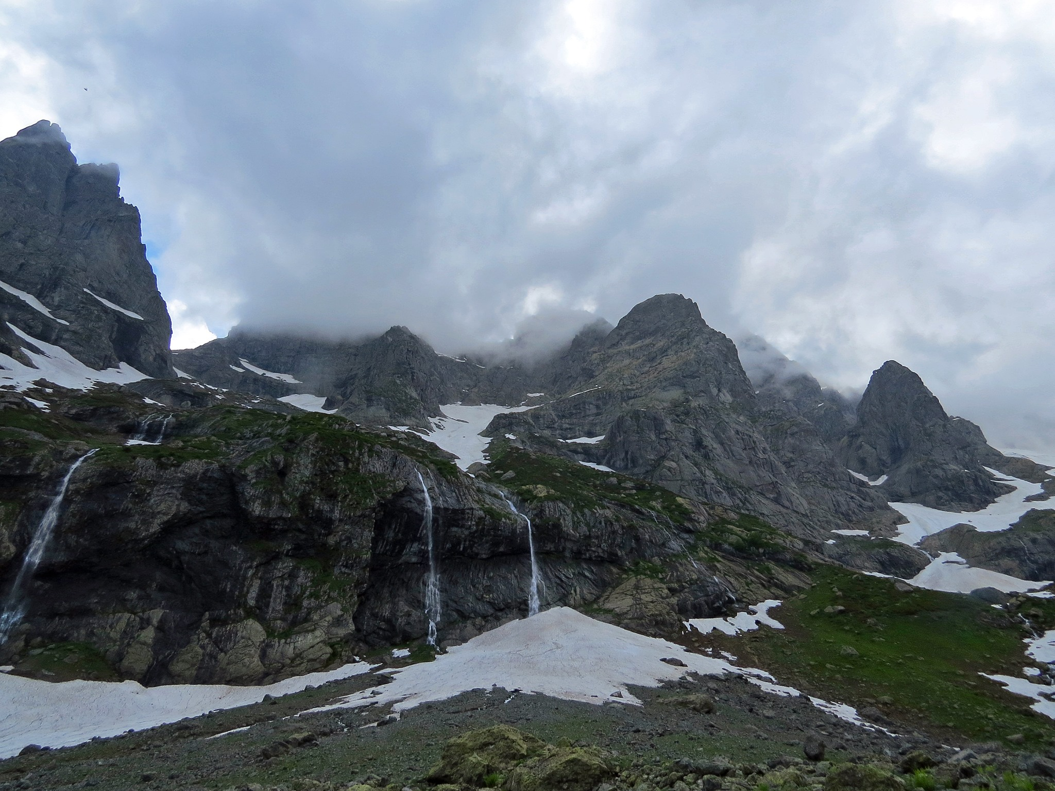
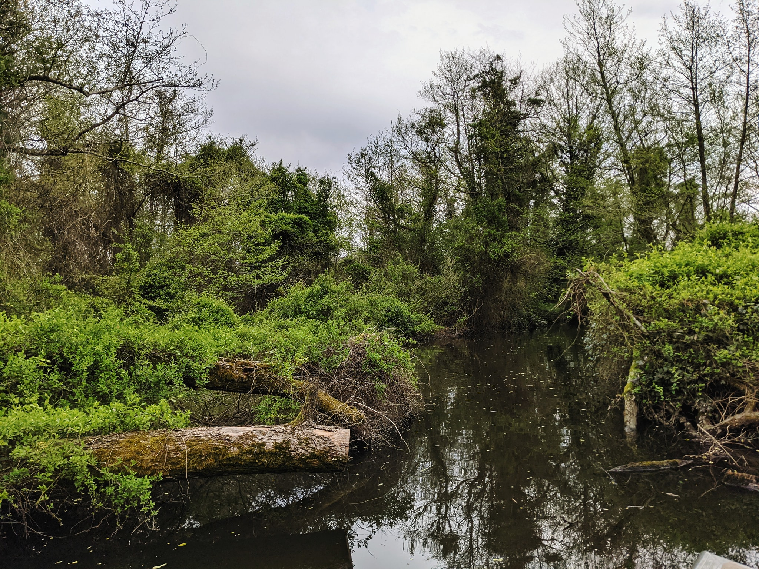
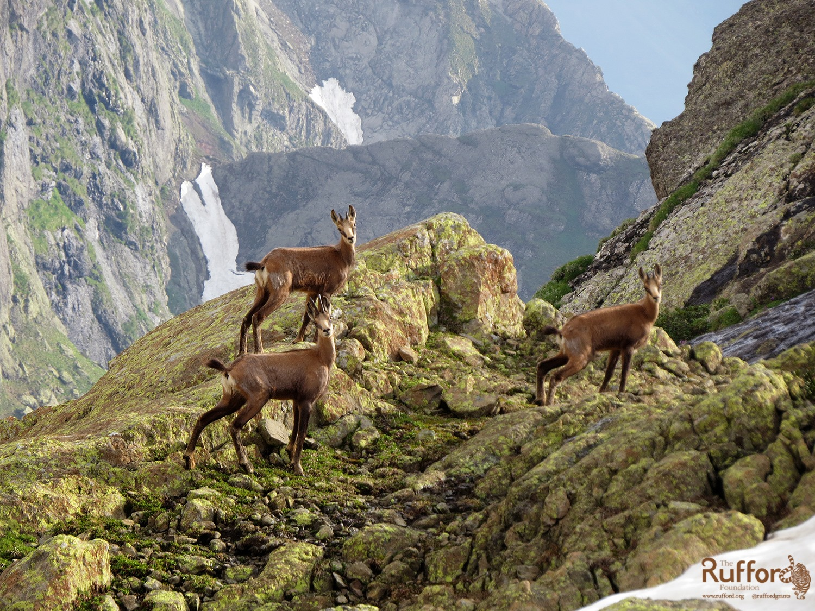
Biodiversity In Georgia
The Caucasus is recognized as one of the 36 biodiversity hot spots by the Critical Ecosystem Partnership Fund. The region's geophysical and climatic characteristics result in a wide range of habitats within a relatively small area.
Georgia encompasses a significant portion of the Caucasian Eco-region and serves as a refuge for unique wild communities, consisting of relict, endemic, and rare specimens of flora, and fauna.

Slide 5
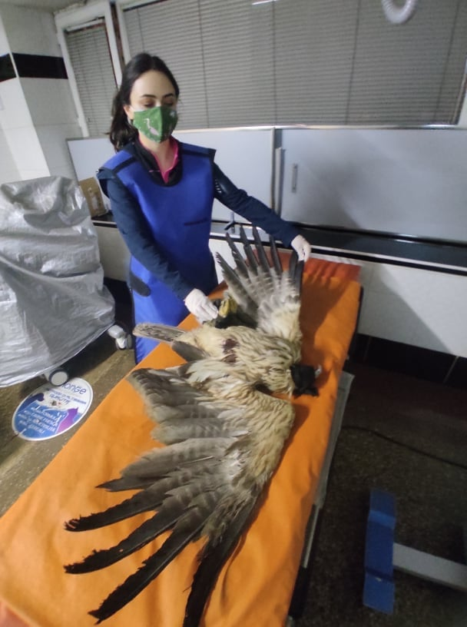
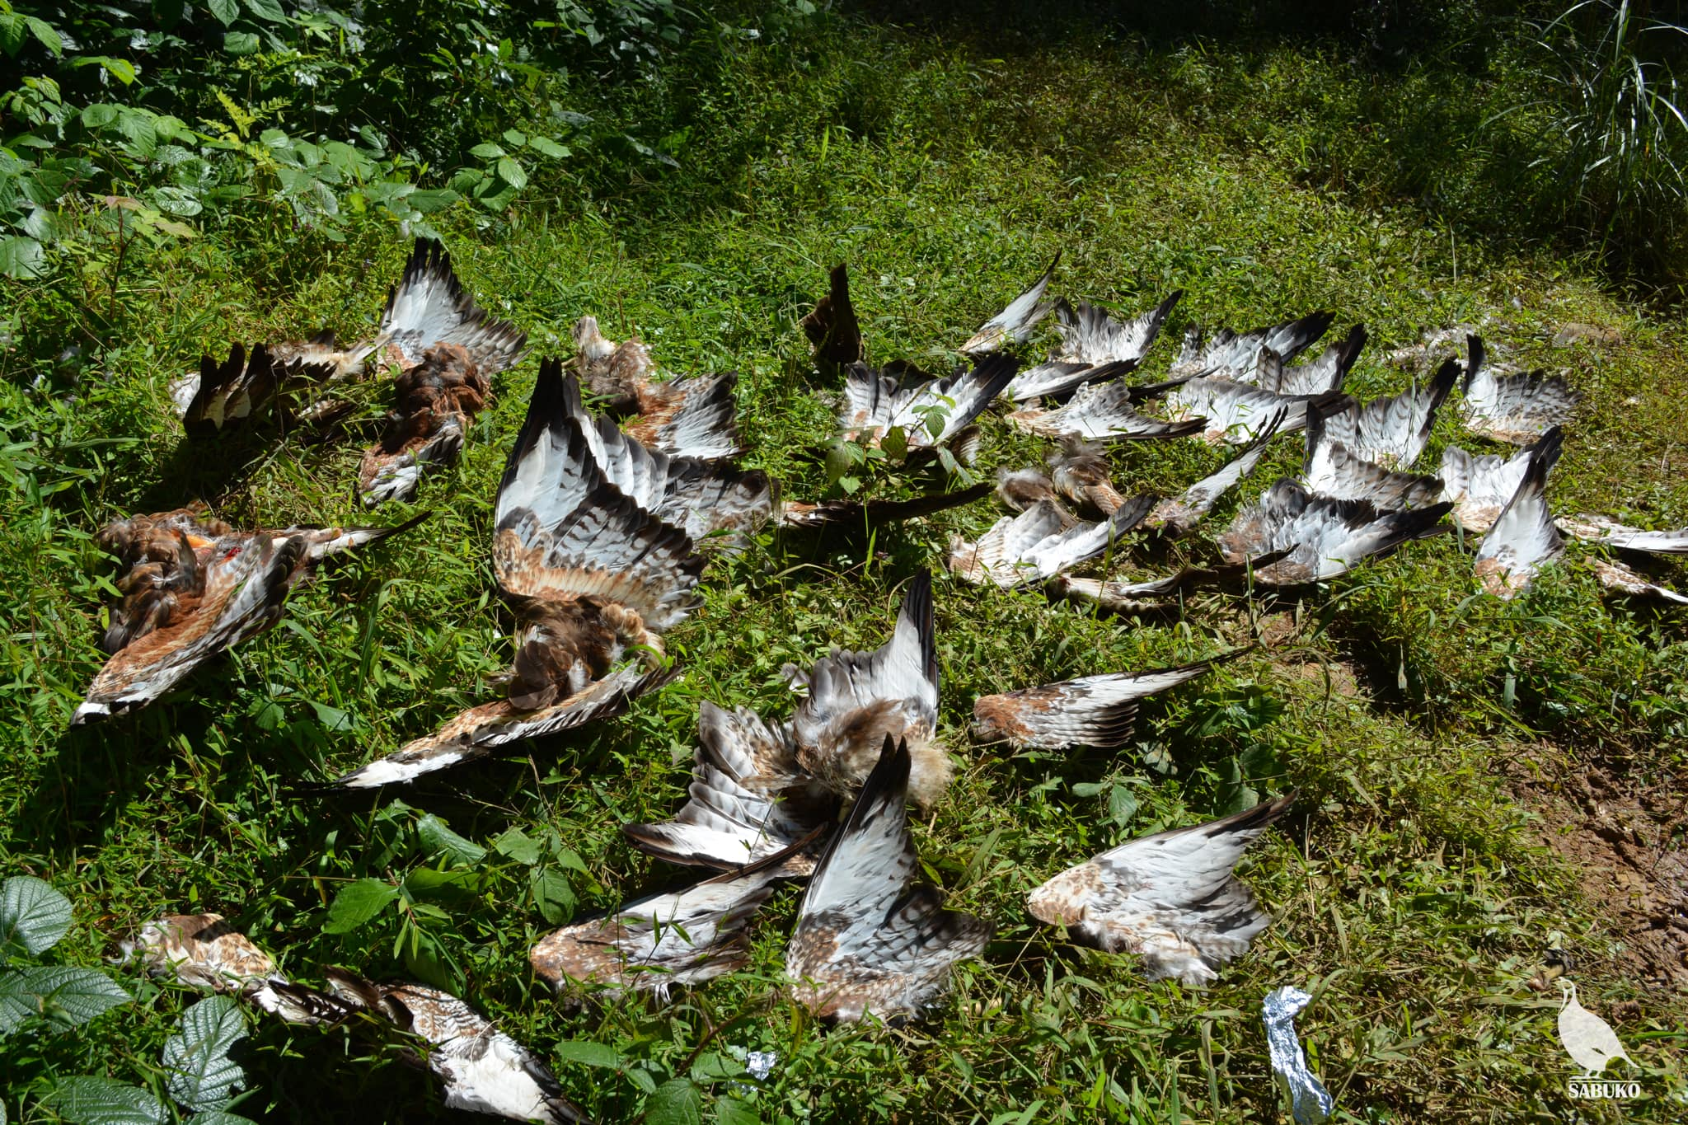
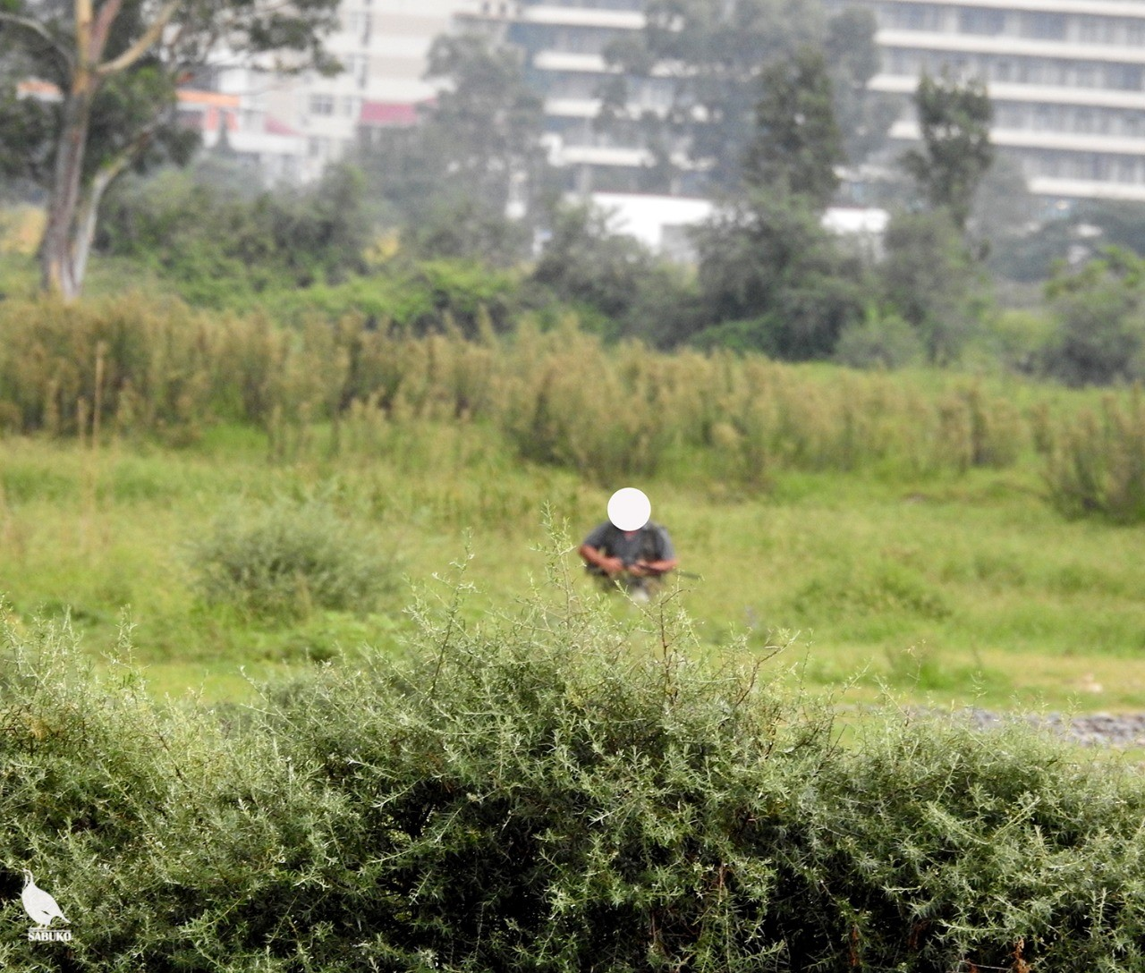
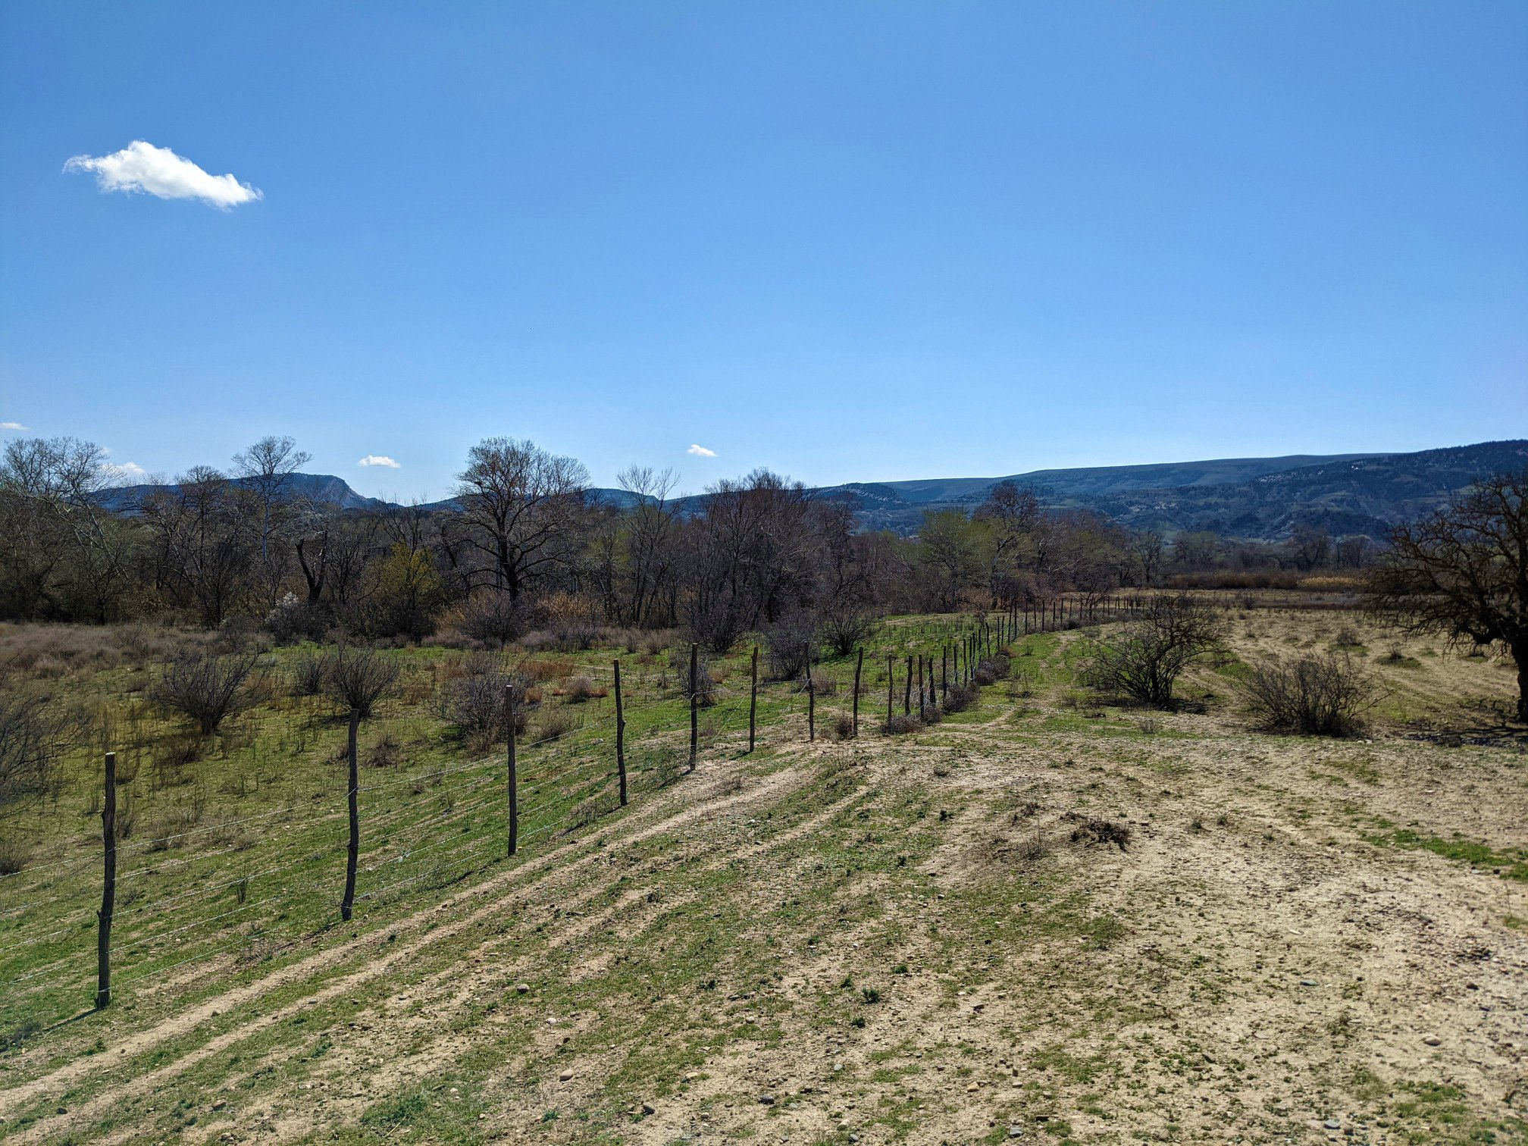
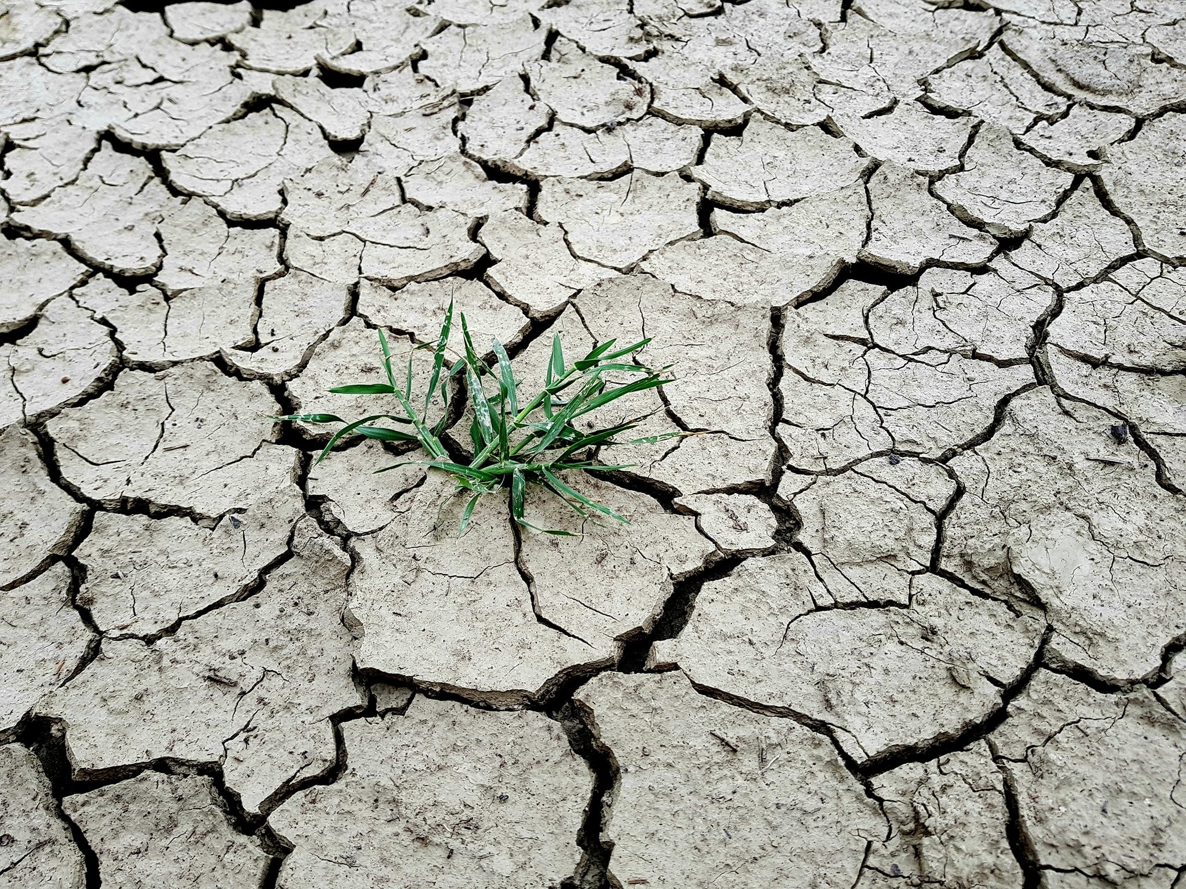
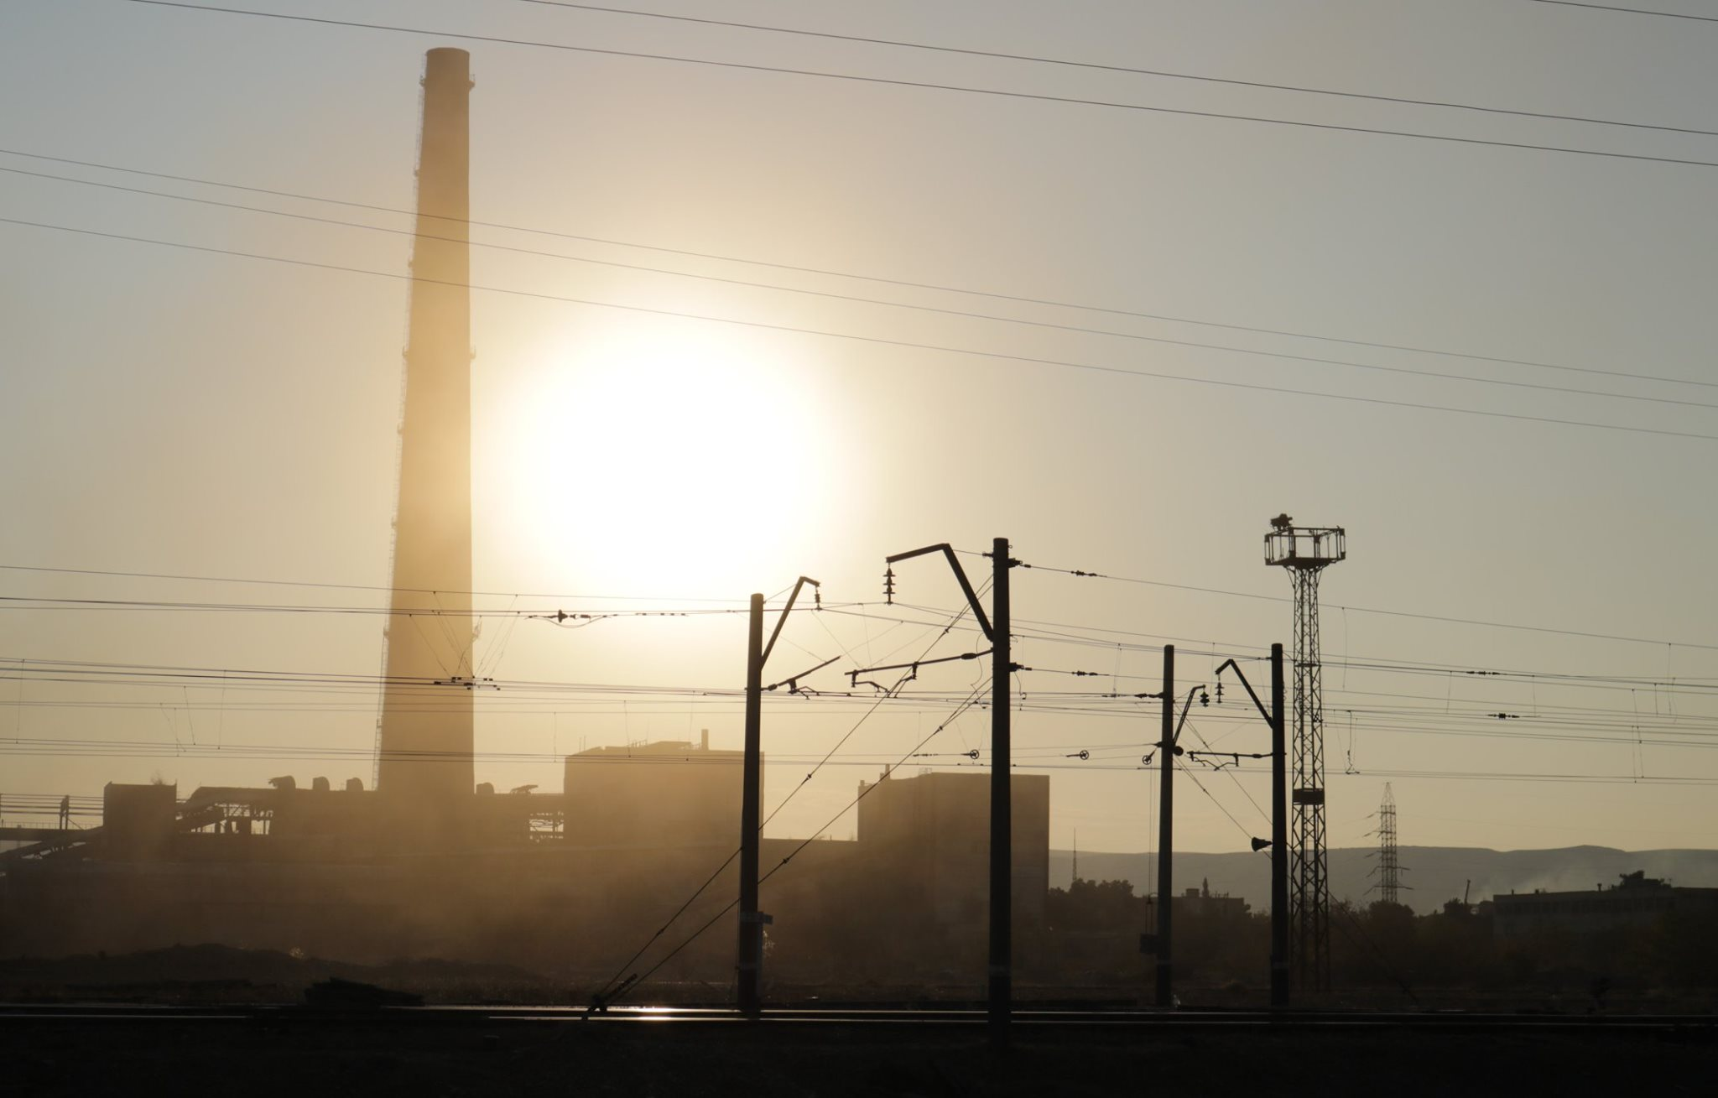
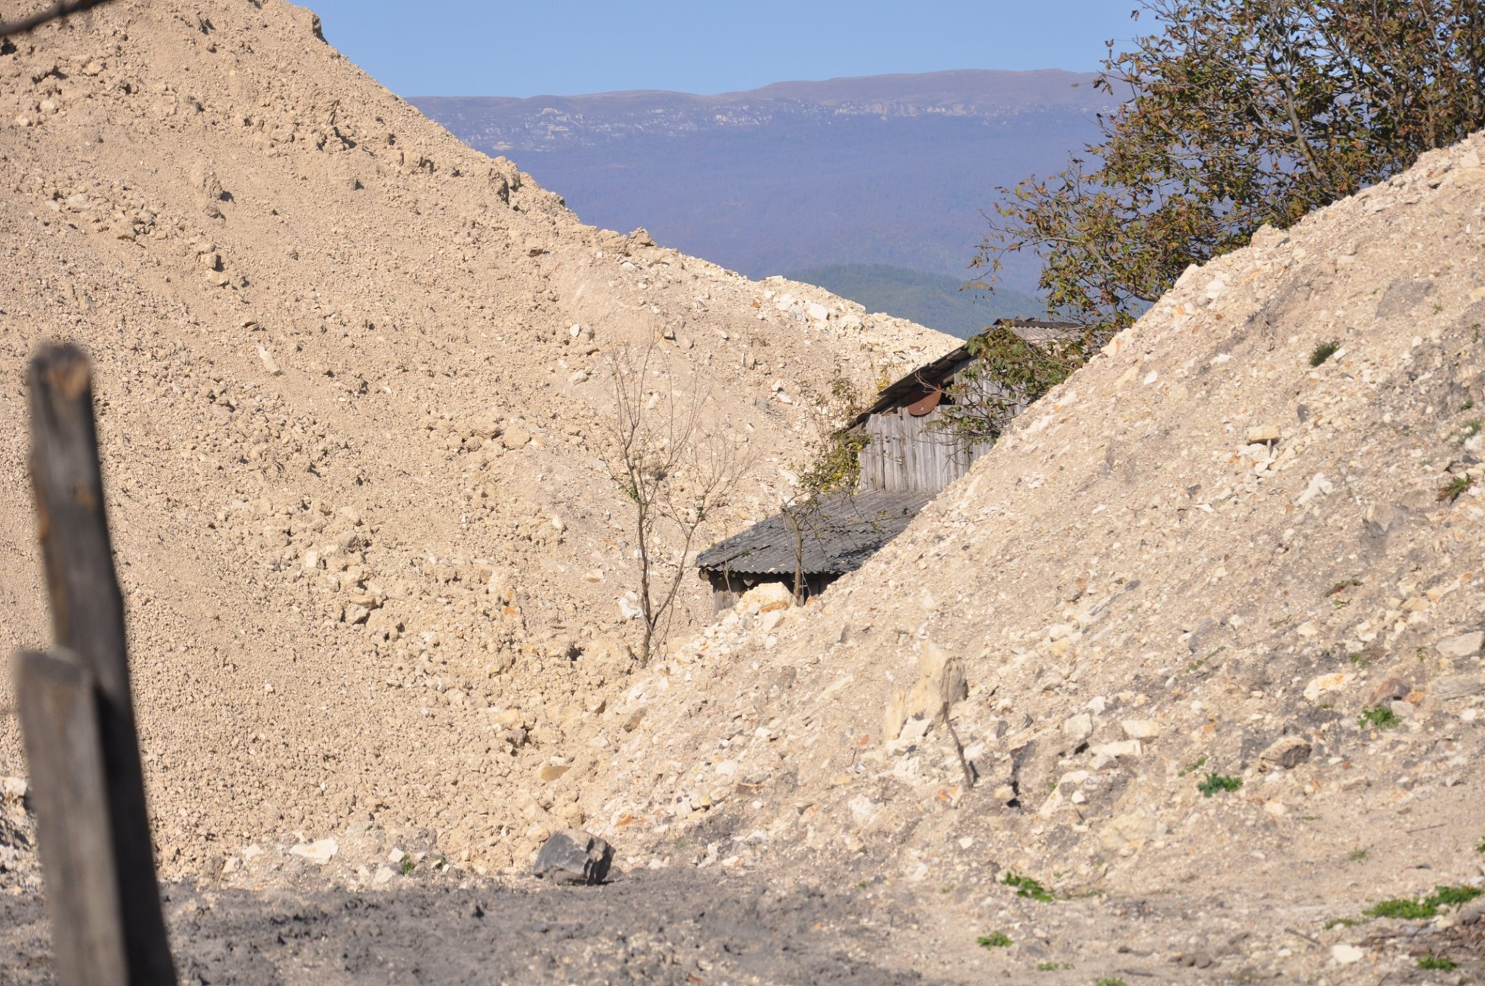
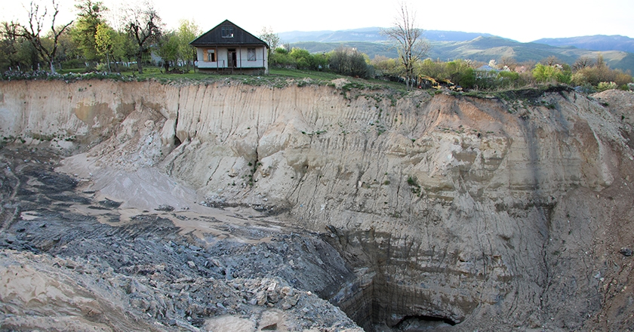
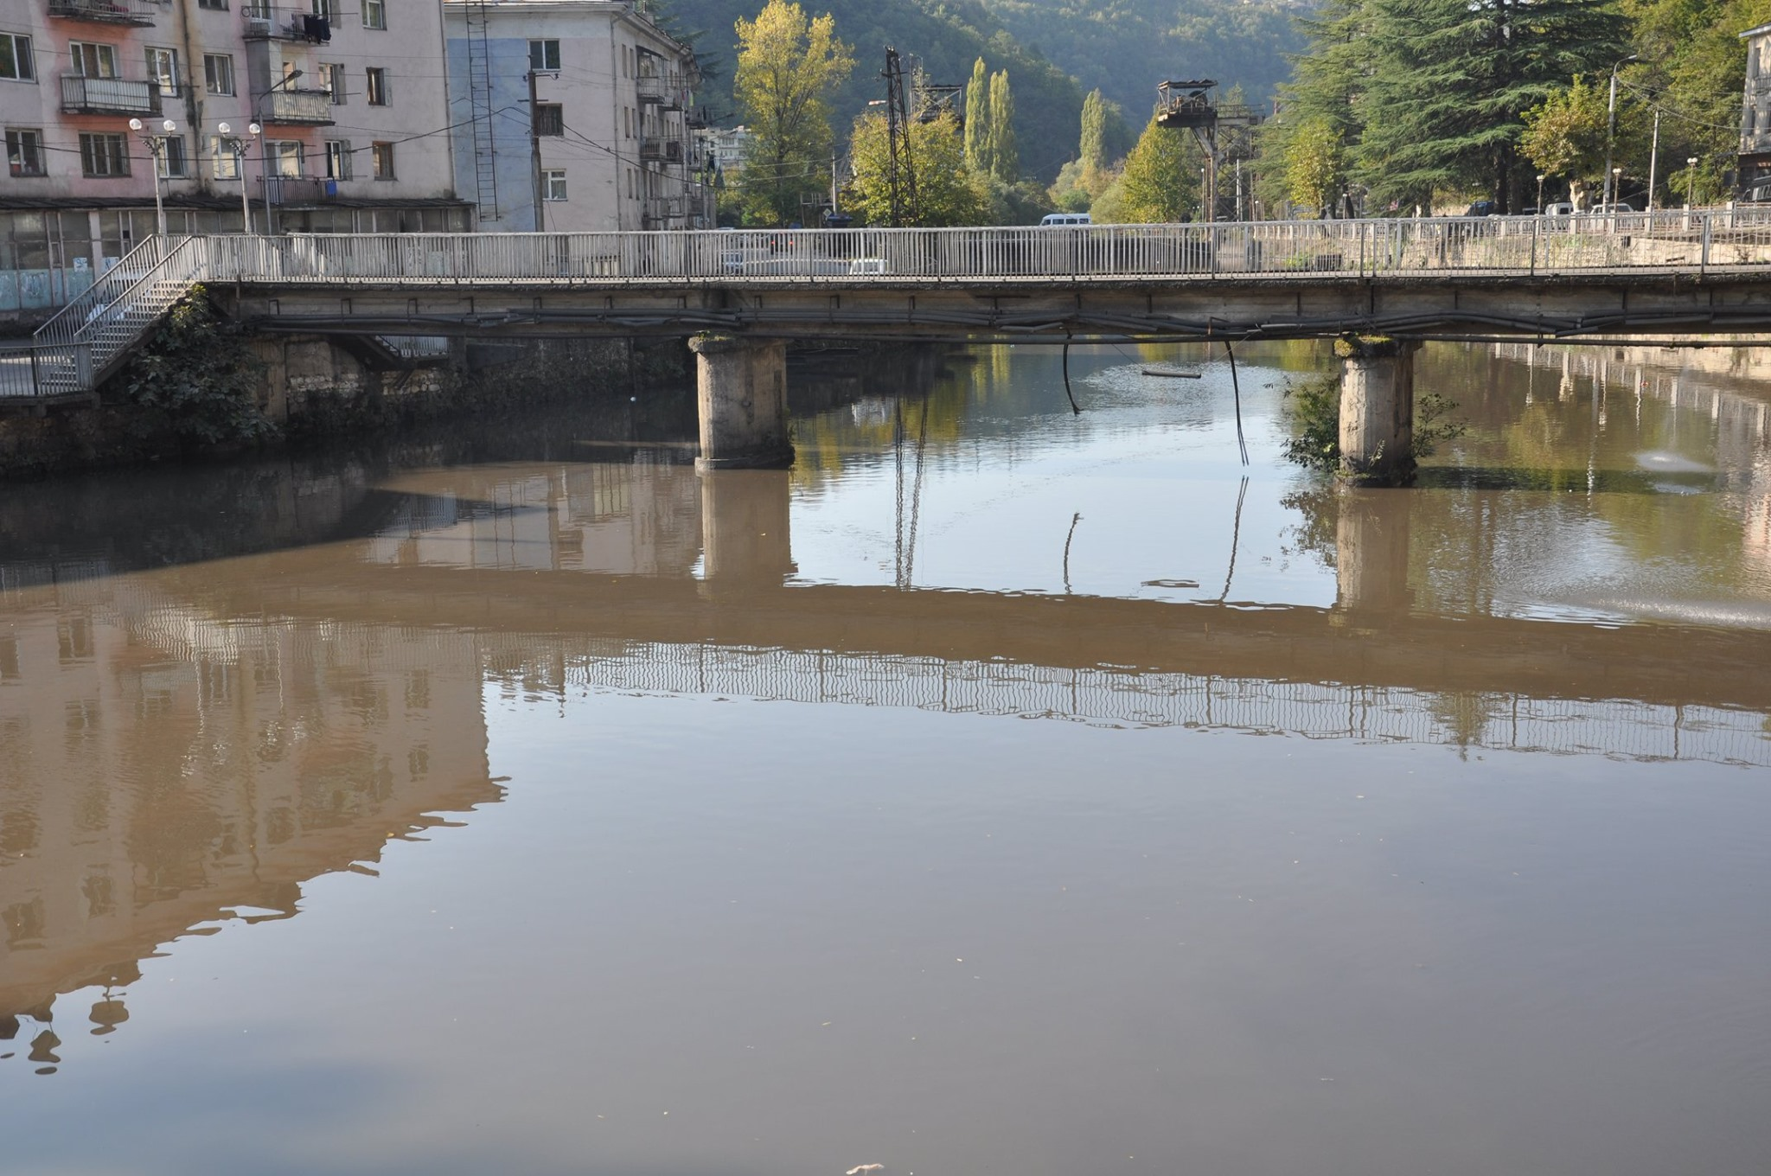
Threats to Biodiversity
Threats to Biodiversity are habitat loss, pollution, climate change, unsustainable resource extraction
And
Poaching!

Slide 6
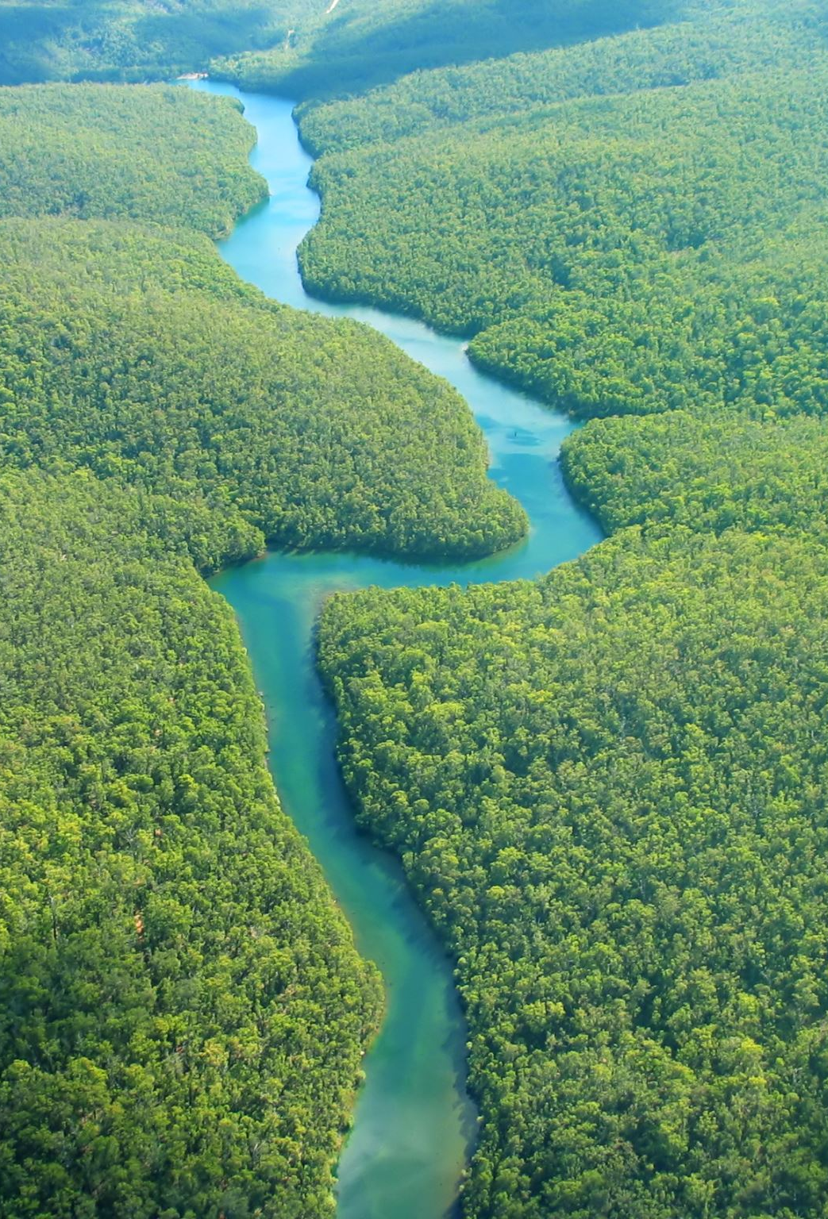
Conservation Strategies
Legislation and Policy: The government of Georgia has established laws and regulations to protect its natural resources. The Law on Environmental Protection and the Law on Biodiversity Conservation are key legal frameworks
Protected Areas: Georgia has a network of protected areas, including national parks, nature reserves, and strict nature reserves.
International Cooperation: Georgia collaborates with international organizations, such as the United Nations Development Programme (UNDP) and the European Union, to implement nature conservation projects, share expertise, and access funding for conservation initiatives.
But again, the problem is law enforcement...

Slide 7
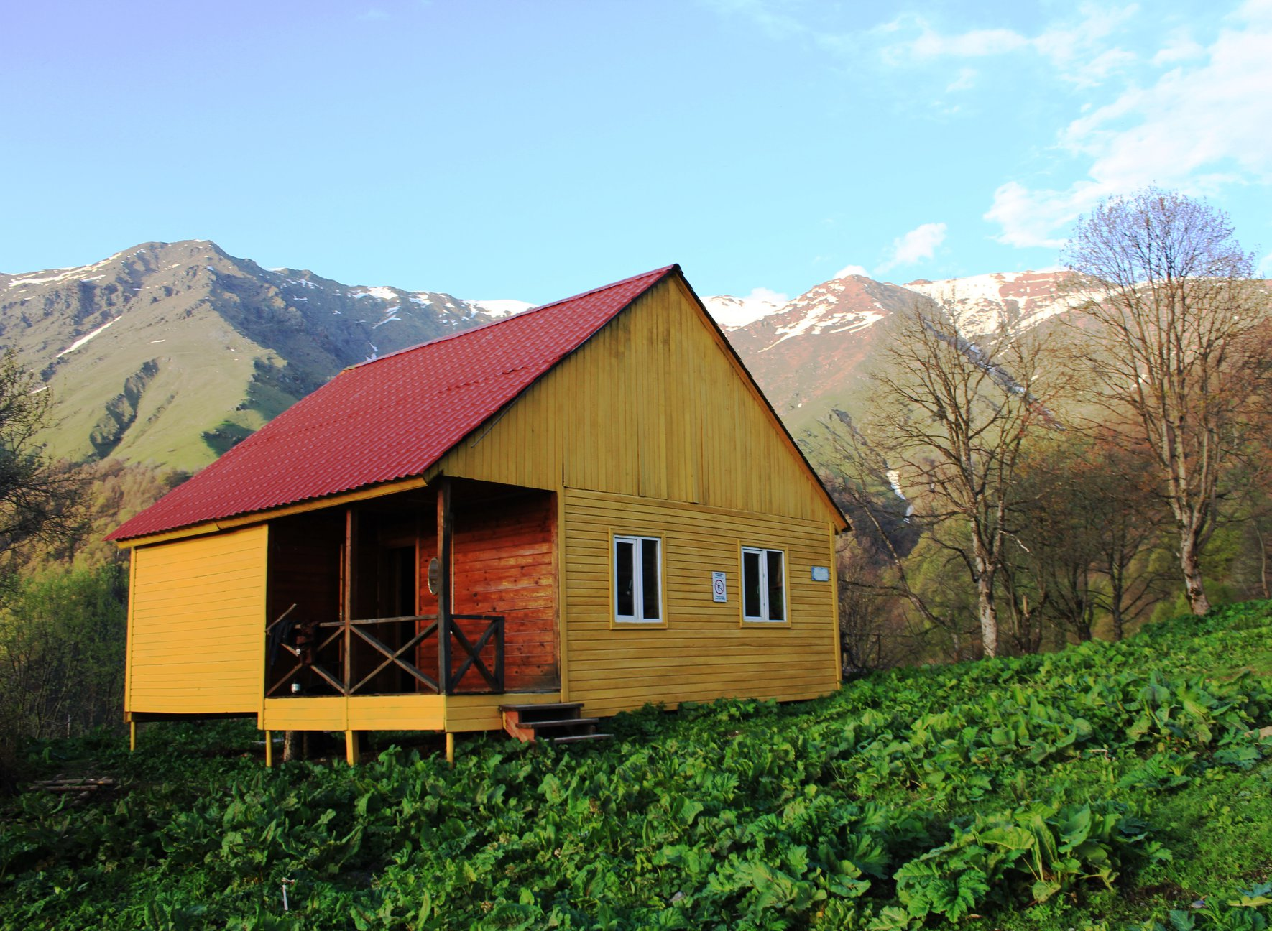
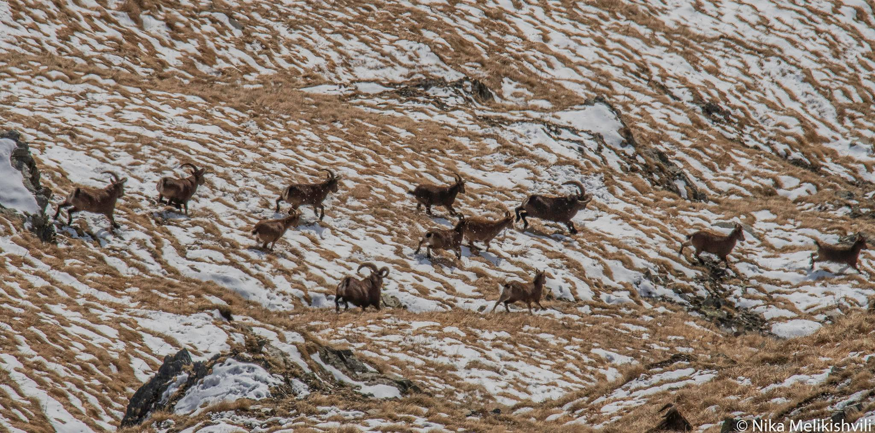
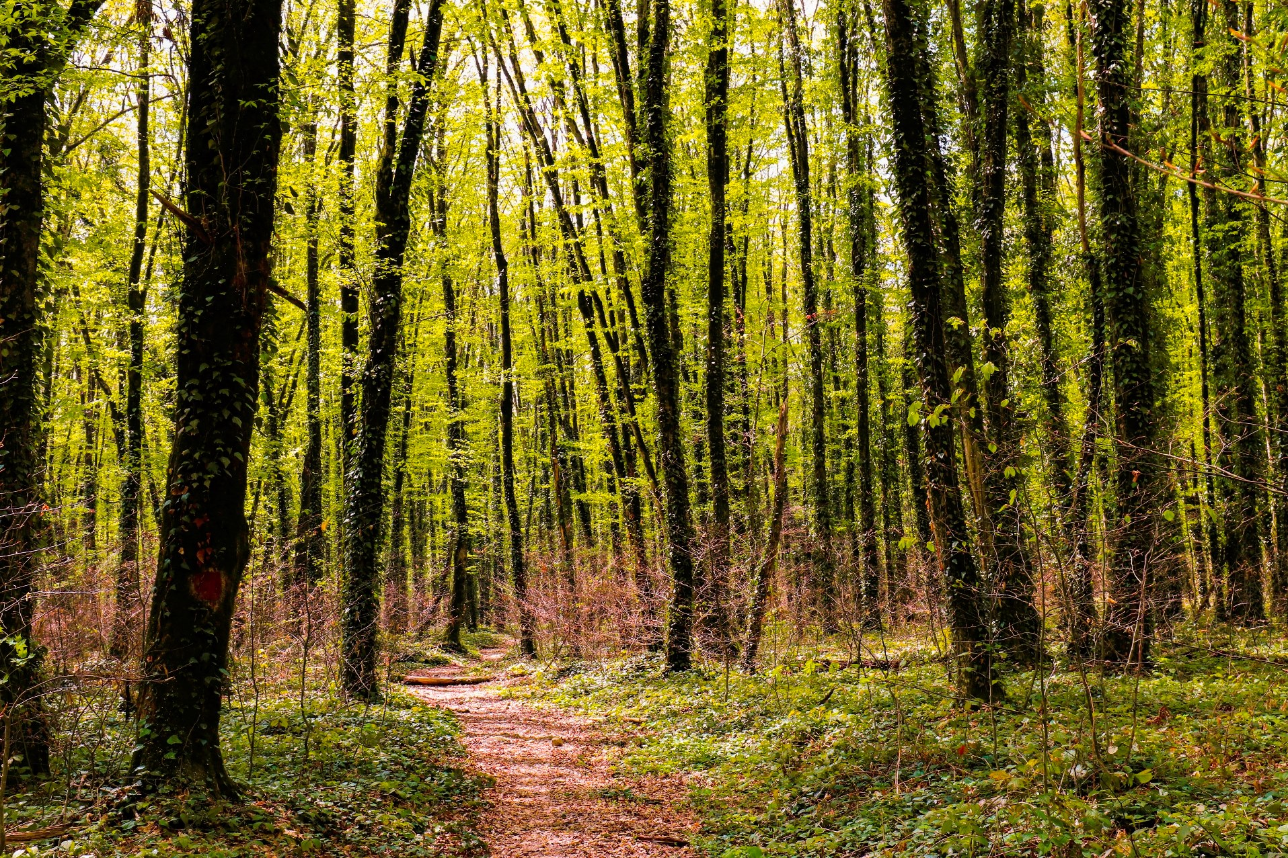
Role of Government What are they doing?
Creating protected areas, environmental policies, and regulations
For example
Lagodekhi protected area

Slide 8
Private Sector and CSR
Lack of general public awareness about the importance of nature
Private sector can contribute to conservation efforts through sustainable practices and environmental initiatives;
Showcase examples for their clients of private sector involvement in Georgia's conservation projects.

Slide 9
Private Sector Initiatives in Georgia
TBC Bank: TBC Bank has incorporated environmental sustainability into its CSR activities, including projects focused on renewable energy, waste management, and environmental education.
Georgian Water and Power (GWP): GWP, a leading water supply and wastewater treatment company in Georgia, has implemented sustainable practices to protect water resources and reduce environmental impact. They prioritize efficient water management, water conservation awareness campaigns, and investments in wastewater treatment infrastructure.
Borjomi: Borjomi, a renowned Georgian mineral water brand, is committed to environmental sustainability. They have implemented various initiatives to protect the natural sources of their water, including reforestation projects, biodiversity conservation efforts, and sustainable packaging practices.
Barambo: Barambo, a leading confectionery and dairy company, has integrated environmental stewardship into its CSR activities. They have implemented energy-efficient measures in their production facilities, promote responsible waste management, and support environmental education programs.

Slide 10
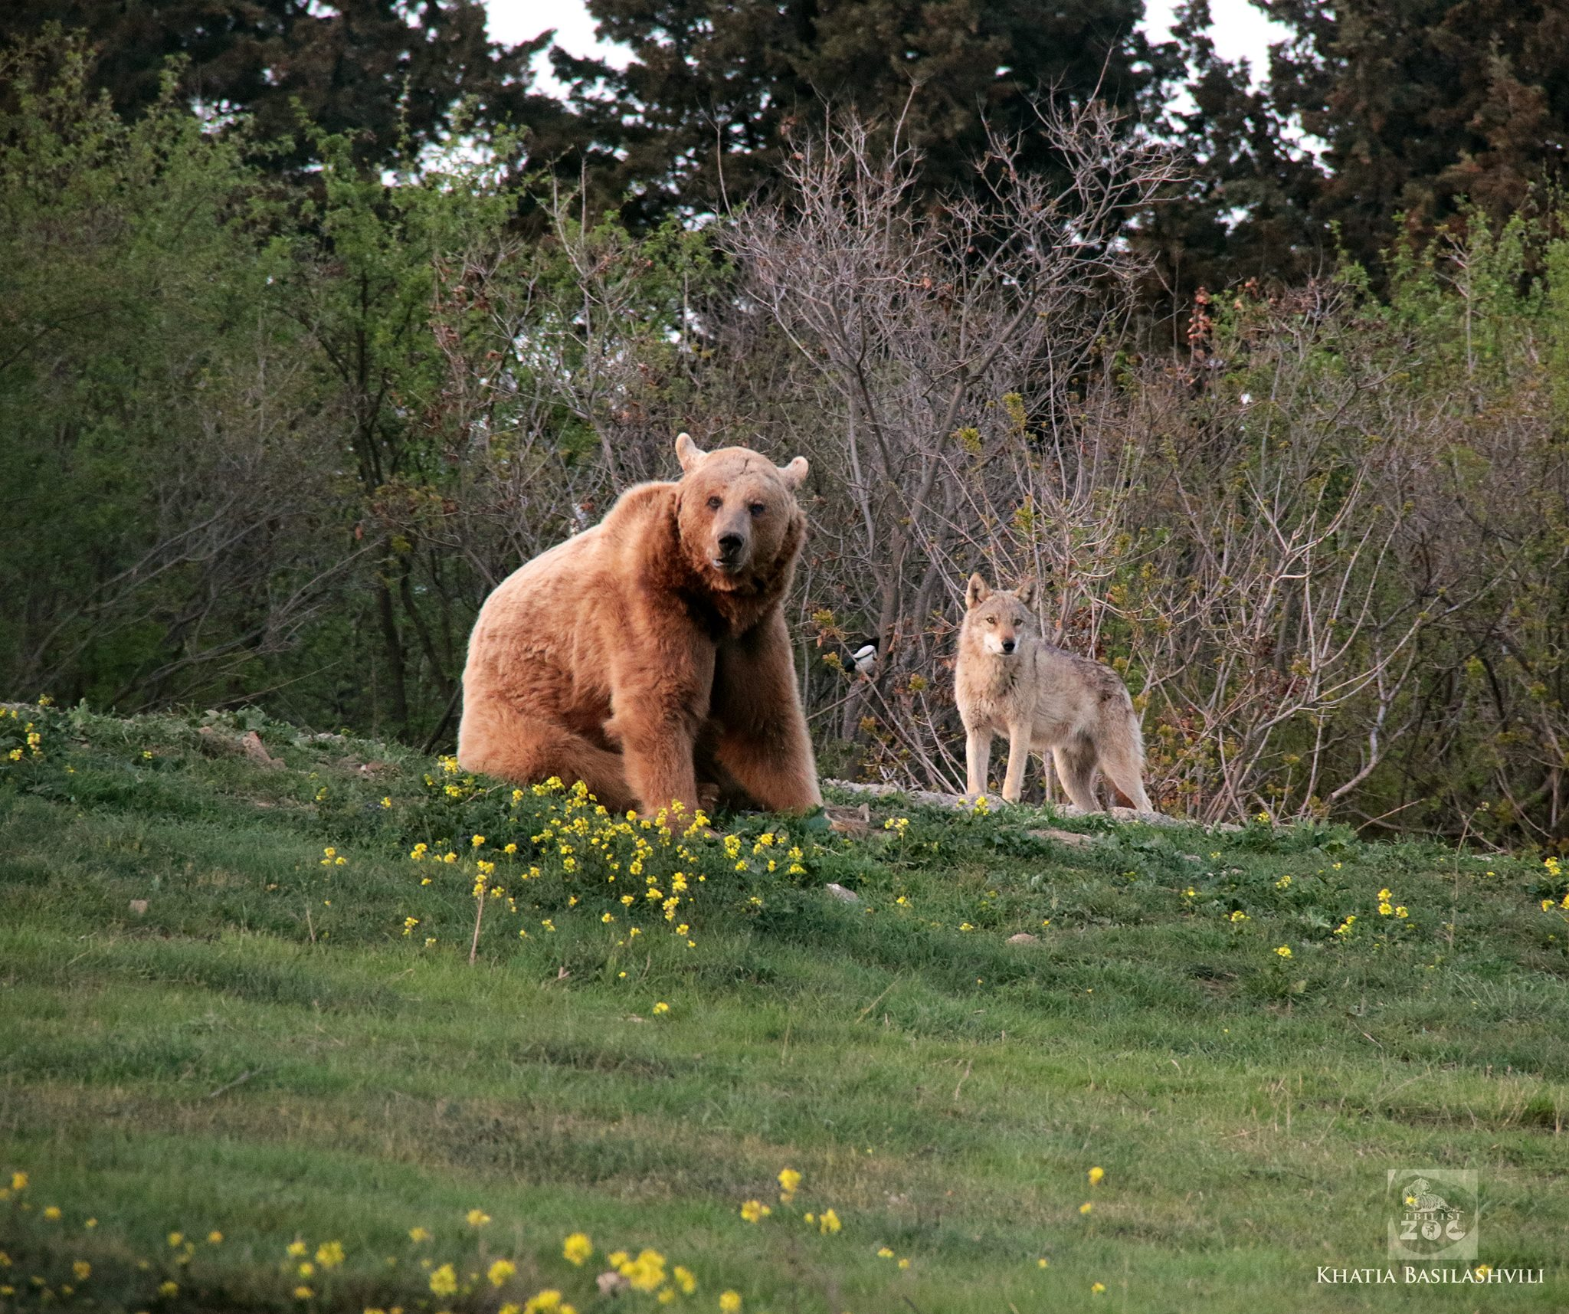
Case study
Bank of Georgia and Tbilisi zoo

Slide 11
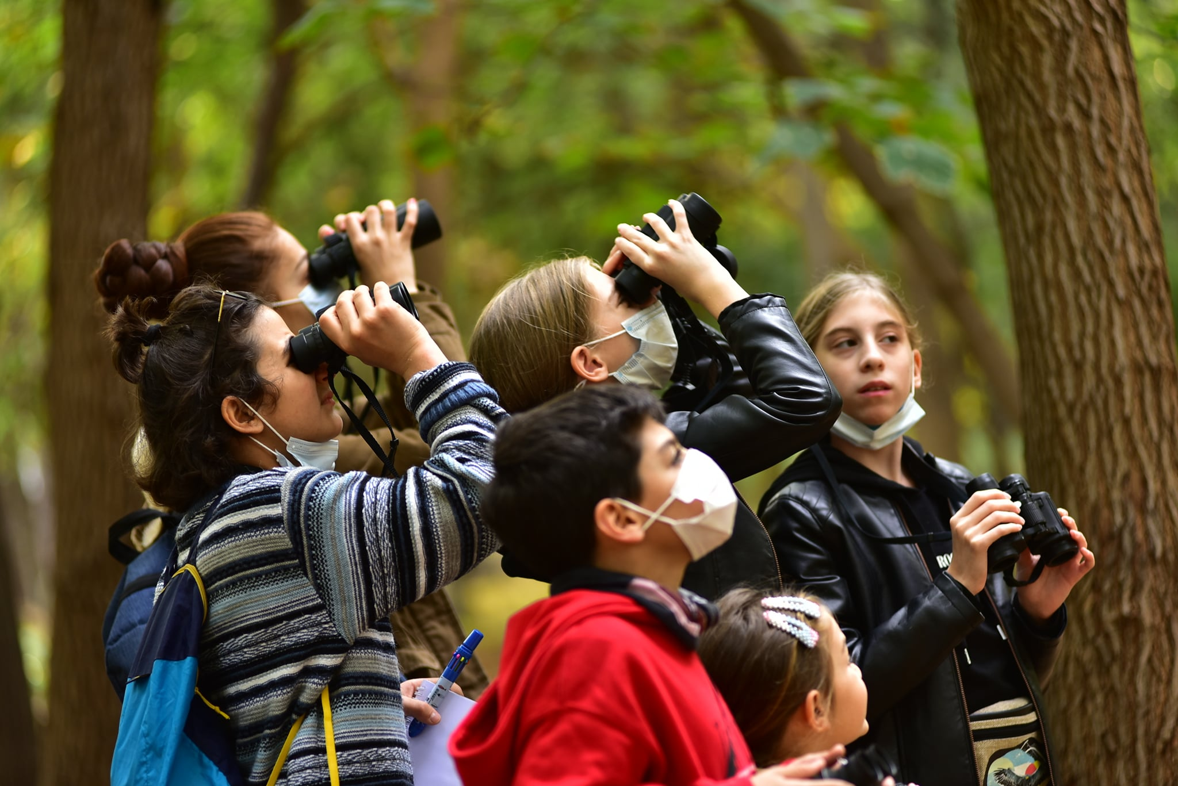
HeidelbergCement
Heidelbercement has been supporting the Spring Alive programme in Georgia, which aims to inspire and educate children across Africa and Eurasia about the wonders of nature and bird migration. SpringAlive is a simple, international project. It’s core activity is creating real-time, interactive observation map. With SpringAlive, SABUKO supports teachers, educators and children with education materials, ideas and contests.
In 2020 SABUKO carried out a two-day spring camp on one of the HeidelbergCement quarries with the company’s support. School children visited active and inactive quarries, learnt the differences among them, observed biodiversity and discussed the restoration process. They experimented with soil, learnt how to differentiate different types of soil. The camp program ended with the excursion in Eagle Valley and observing vultures.

Slide 12
Thank you
Questions?
Khatia.basilashvili@gmail.com

